Slide 1
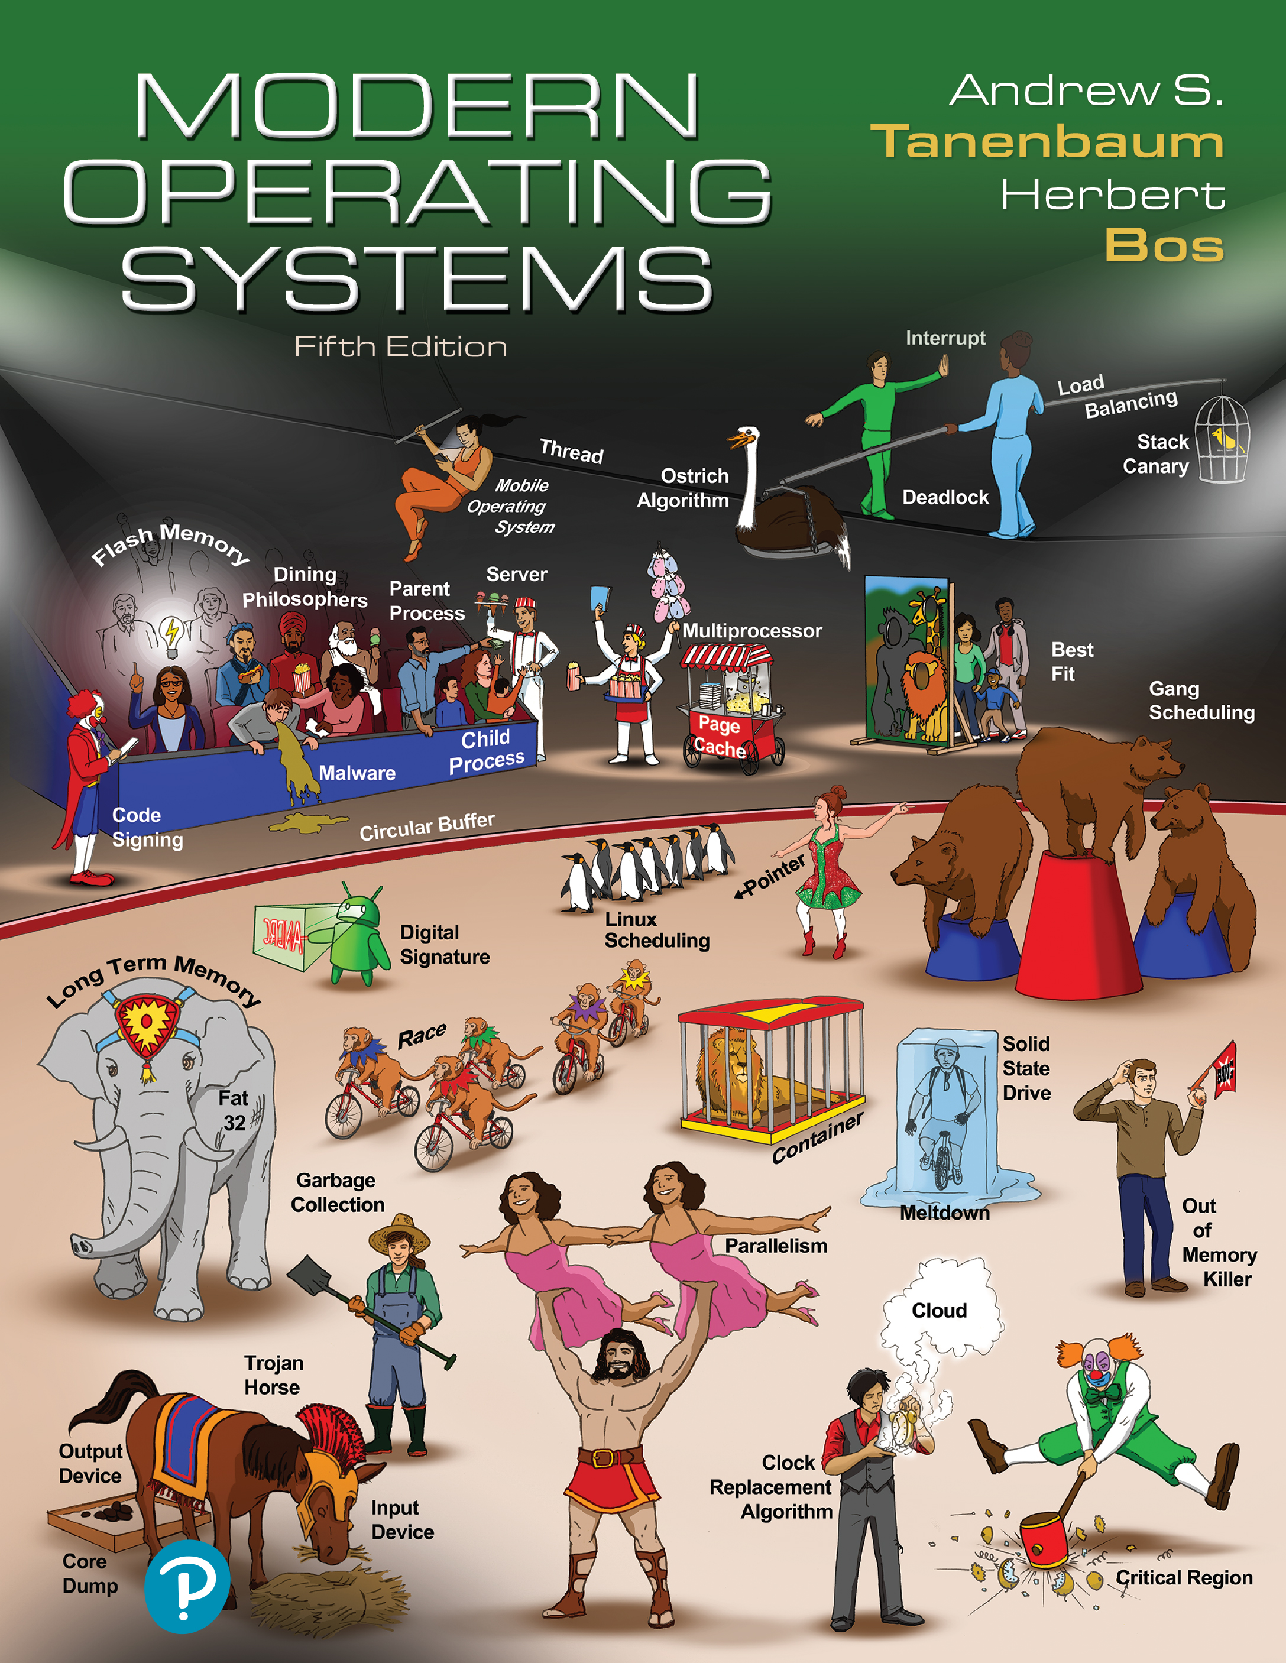

Modern Operating Systems
Fifth Edition
Chapter 1
Introduction
Copyright © 2023, 2014, 2008 Pearson Education, Inc. All Rights Reserved
Notes:
If this PowerPoint presentation contains mathematical equations, you may need to check that your computer has the following installed:
1) Math Type Plugin
2) Math Player (free versions available)
3) NVDA Reader (free versions available)

Slide 2
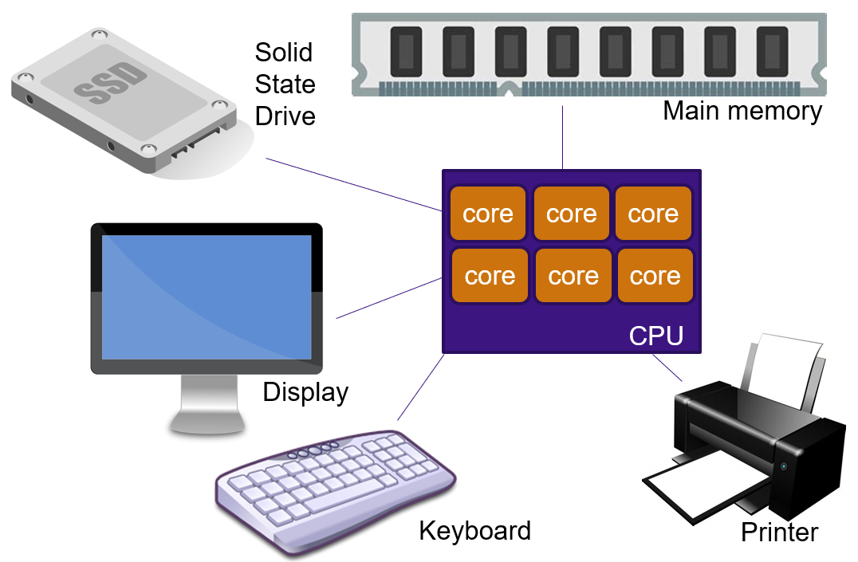
Components of a Modern Computer (1)
One or more processors
Main memory
Disks or Flash drives
Printers
Keyboard
Mouse
Display
Network interfaces
I/O devices
VikiVector/Shutterstock

Slide 3
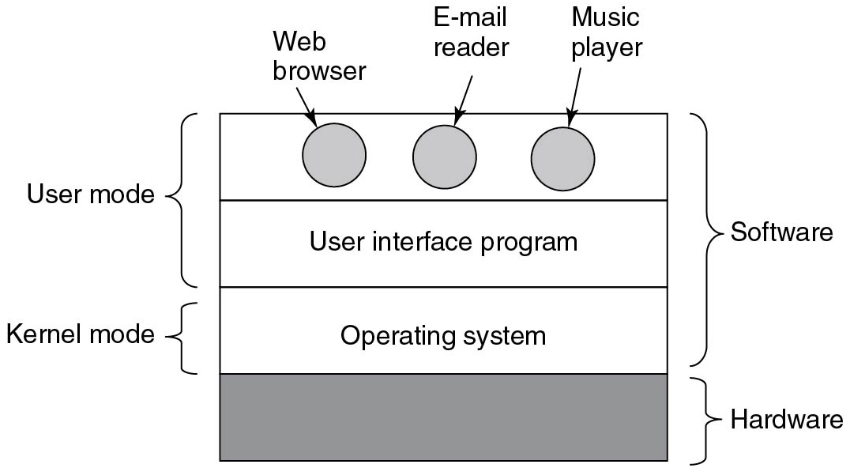
Components of a Modern Computer (2)
Figure 1.1 Where the operating system fits in.
Notes:
Long Description:
A square box has four horizontal partitions, where the lowest or fourth partition is highlighted and labeled Hardware. The third partition is labeled Operating system and categorized as Kernel mode. The second partition is labeled User interface program. The first partition is with three highlighted circles labeled Web browser, E-mail reader, and Music player from left to right. The first and second partition is categorized as User mode. The first, second, and third partitions are categorized as Software.

Slide 4
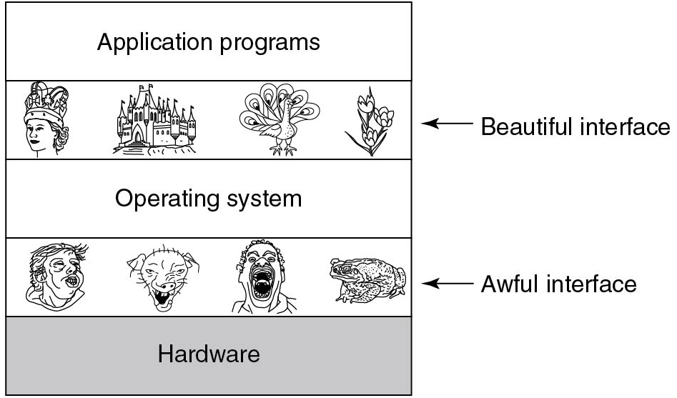
The Operating System as an Extended Machine
Figure 1.2 Operating systems turn awful hardware into beautiful abstractions.
Notes:
Long Description:
A rectangular box has five horizontal partitions, where the lowest or fifth partition is highlighted and labeled Hardware. The fourth partition has four abstract pictures and is categorized as Awful Interface. The third partition is labeled Operating System. The second partition has abstract pictures and is categorized as Beautiful Interface. The first partition is labeled Application programs.

Slide 5
The Operating System as a Resource Manager
Top-down view
Provide abstractions to application programs
Bottom-up view
Manage pieces of complex system
Provide orderly, controlled allocation of resources

Slide 6
History of Operating Systems
The first generation (1945-55): Vacuum tubes
The second generation (1955-65): Transistors and batch systems
The third generation (1965-1980): I C s and multiprogramming
The fourth generation (1980-present): Personal computers
The fifth generation (1990-present): Mobile computers

Slide 7
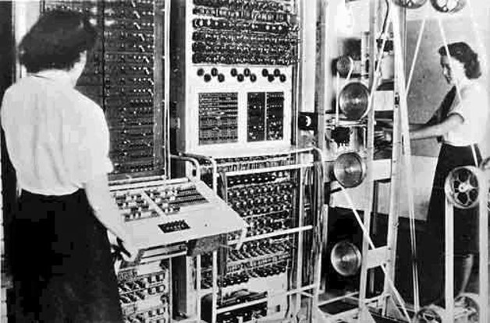
First Generation: Vacuum tubes
Annotated photographs of the COLOSSUS electronic digital computer/Kew/National Archives and Records Administration (N A R A) [F O 850/234]
The Colossus Mark 2 computer: Cryptanalysis of the Lorenz Cipher

Slide 8
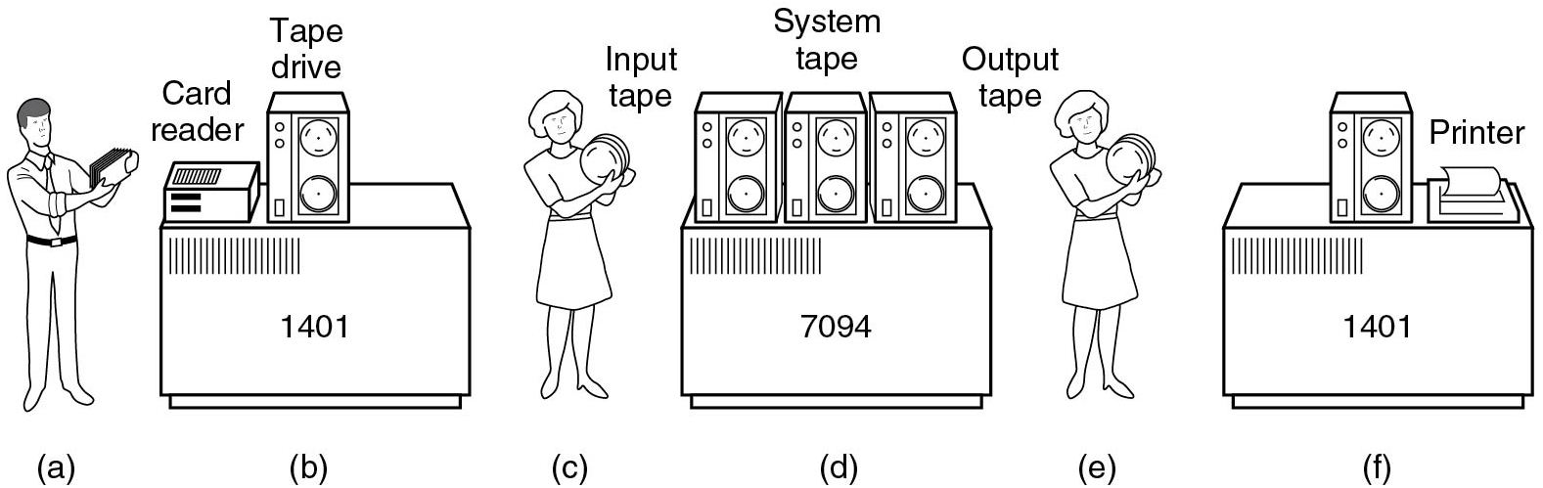
Second Generation: Transistors and Batch Systems (1)
Figure 1.3 An early batch system. (a) Programmers bring cards to 1401. (b) 1401 reads batch of jobs onto tape…
Notes:
Long Description:
Part (a): Programmers bring cards to 1401. Part (b): 1401 reads a batch of jobs onto tape. Part (c): The operator carries input tape to 7094. Part (d): 7094 consists of a System tape and does computing. Part (e): The operator carries output tape to 1401. Part (f): 1401 prints output.

Slide 9
Second Generation: Transistors and Batch Systems (2)
Figure 1.3 An early batch system.… (c) Operator carries input tape to 7094. (d) 7094 does computing. (e) Operator carries output tape to 1401. (f) 1401 prints output.
Notes:
Long Description:
Part (a): Programmers bring cards to 1401. Part (b): 1401 reads a batch of jobs onto tape. Part (c): The operator carries input tape to 7094. Part (d): 7094 consists of a System tape and does computing. Part (e): The operator carries output tape to 1401. Part (f): 1401 prints output.

Slide 10
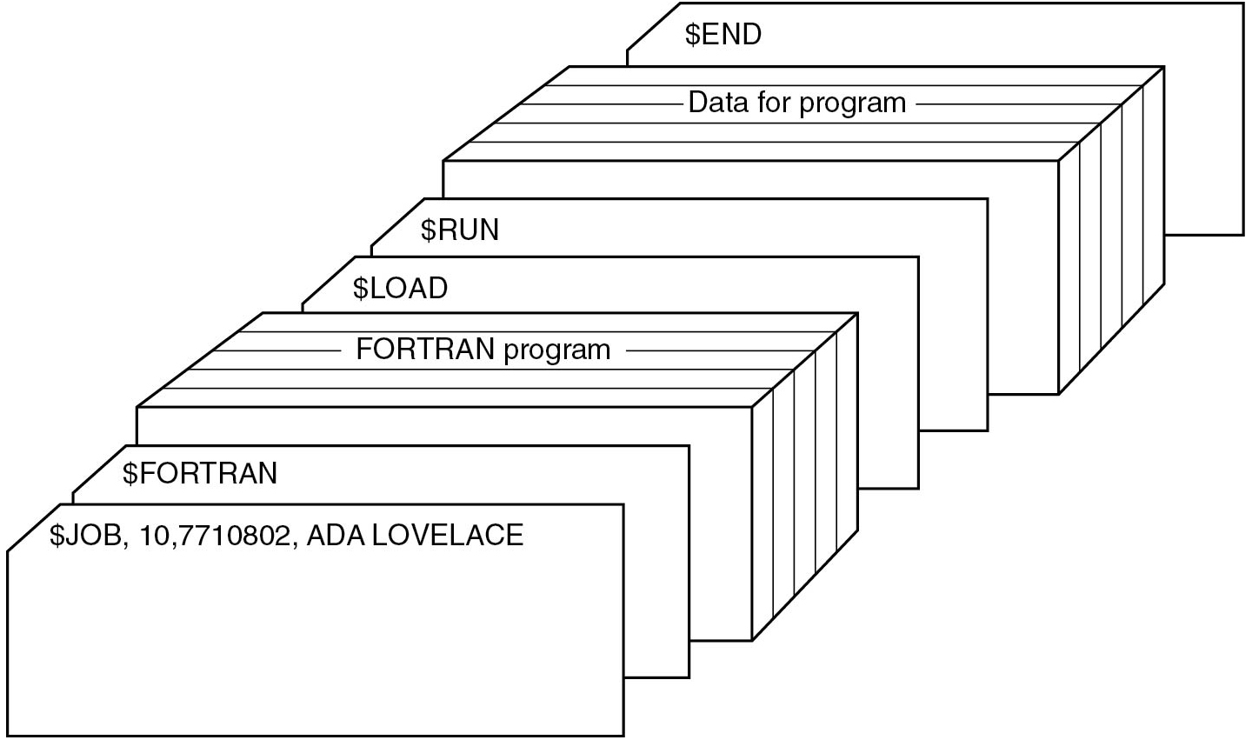
Second Generation: Transistors and Batch Systems (3)
Figure 1.4 Structure of a typical F M S job.
Notes:
Long Description:
Different cards are arranged one behind the other. The first card is a dollar JOB card, labeled dollar JOB, 10,7710802, ADA LOVELACE. Another card behind it is labeled dollar FORTRAN. Behind this, there are several cards, labeled together as FORTRAN program. Behind this, a card is labeled dollar LOAD. Behind this, a card is labeled dollar RUN. Behind this, there are several cards, labeled together as Data for program. Behind this, a card is labeled dollar END that depicts the end of the job

Slide 11
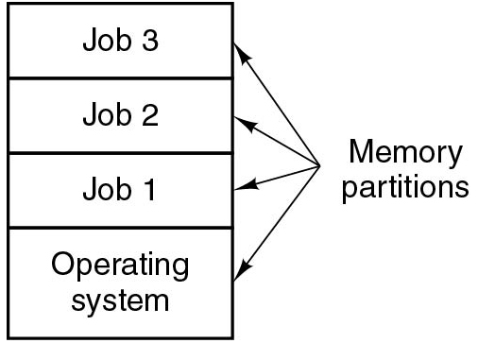
Third Generation: I C s and Multiprogramming
Figure 1.5 A multiprogramming system with three jobs in memory.
Notes:
Long Description:
A square-shaped block has four partitions categorized as Memory Partitions. The lowest or first partition is labeled Operating System. The second partition is labeled Job 1. The third partition is labeled Job 2. The first partition is labeled Job 3.

Slide 12
Timesharing

Slide 13
Timesharing and Multics
“I remarked to Dennis that easily half the code I was writing in Multics was error recovery code”.
—Tom Van Vleck, 1973
Multics introduced many novel features that we find in O S s today. It was also complex.

Slide 14
U N I X – a Simpler Operating System
Courtesy of the Computer History Museum
/*
* You are not expected to understand this.
*/
Comment by Ken Thompson in the source code of UNIXv6, 1975. A.k.a the most famous comment ever. Interestingly, the code to which it pertained contained a bug, so perhaps the authors did not understand it either. :)
Notes:
Ken Thompson and Dennis Ritchie developed a simpler O S which they called UNICS (later: UNIX). Many students studied it, especially when John Lions published a line-by-line commentary of the source code. This comment is found in the source. It has become famous.
Image 1 from: https://cdn1.vogel.de/unsafe/fit-in/1000x0/images.vogel.de/vogelonline/bdb/1717400/1717458/original.jpg
Image 2 from: https://upload.wikimedia.org/wikipedia/commons/thumb/5/50/Lions_Commentary_Unix.jpeg/330px-Lions_Commentary_Unix.jpeg

Slide 15
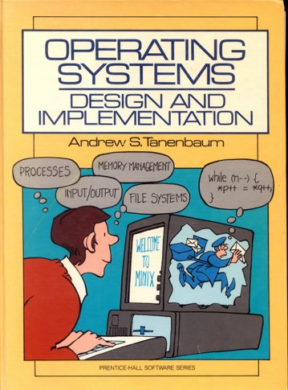
M I N I X (1980s)
Notes:
Image from: Cover of Andy’s older books

Slide 16
Linux (1990s). Source: comp.os.minix
“Hello everybody out there using minix -
I'm doing a (free) operating system (just a hobby, won't be big and
professional like gnu) for 386(486) A T clones. This has been brewing
since april, and is starting to get ready. I'd like any feedback on
things people like/dislike in minix, as my O S resembles it somewhat
(same physical layout of the file-system (due to practical reasons)
among other things).
I've currently ported bash(1.08) and g c c(1.40), and things seem to work.
This implies that I'll get something practical within a few months, and
I'd like to know what features most people would want. Any suggestions
are welcome, but I won't promise I'll implement them :-)
Linus (
torvalds@kruuna.helsinki.fi
)
P S. Yes - it's free of any minix code, and it has a multi-threaded fs.
It is NOT portable (uses 386 task switching etc), and it probably never
will support anything other than A T-harddisks, as that's all I have :-(”.

Slide 17
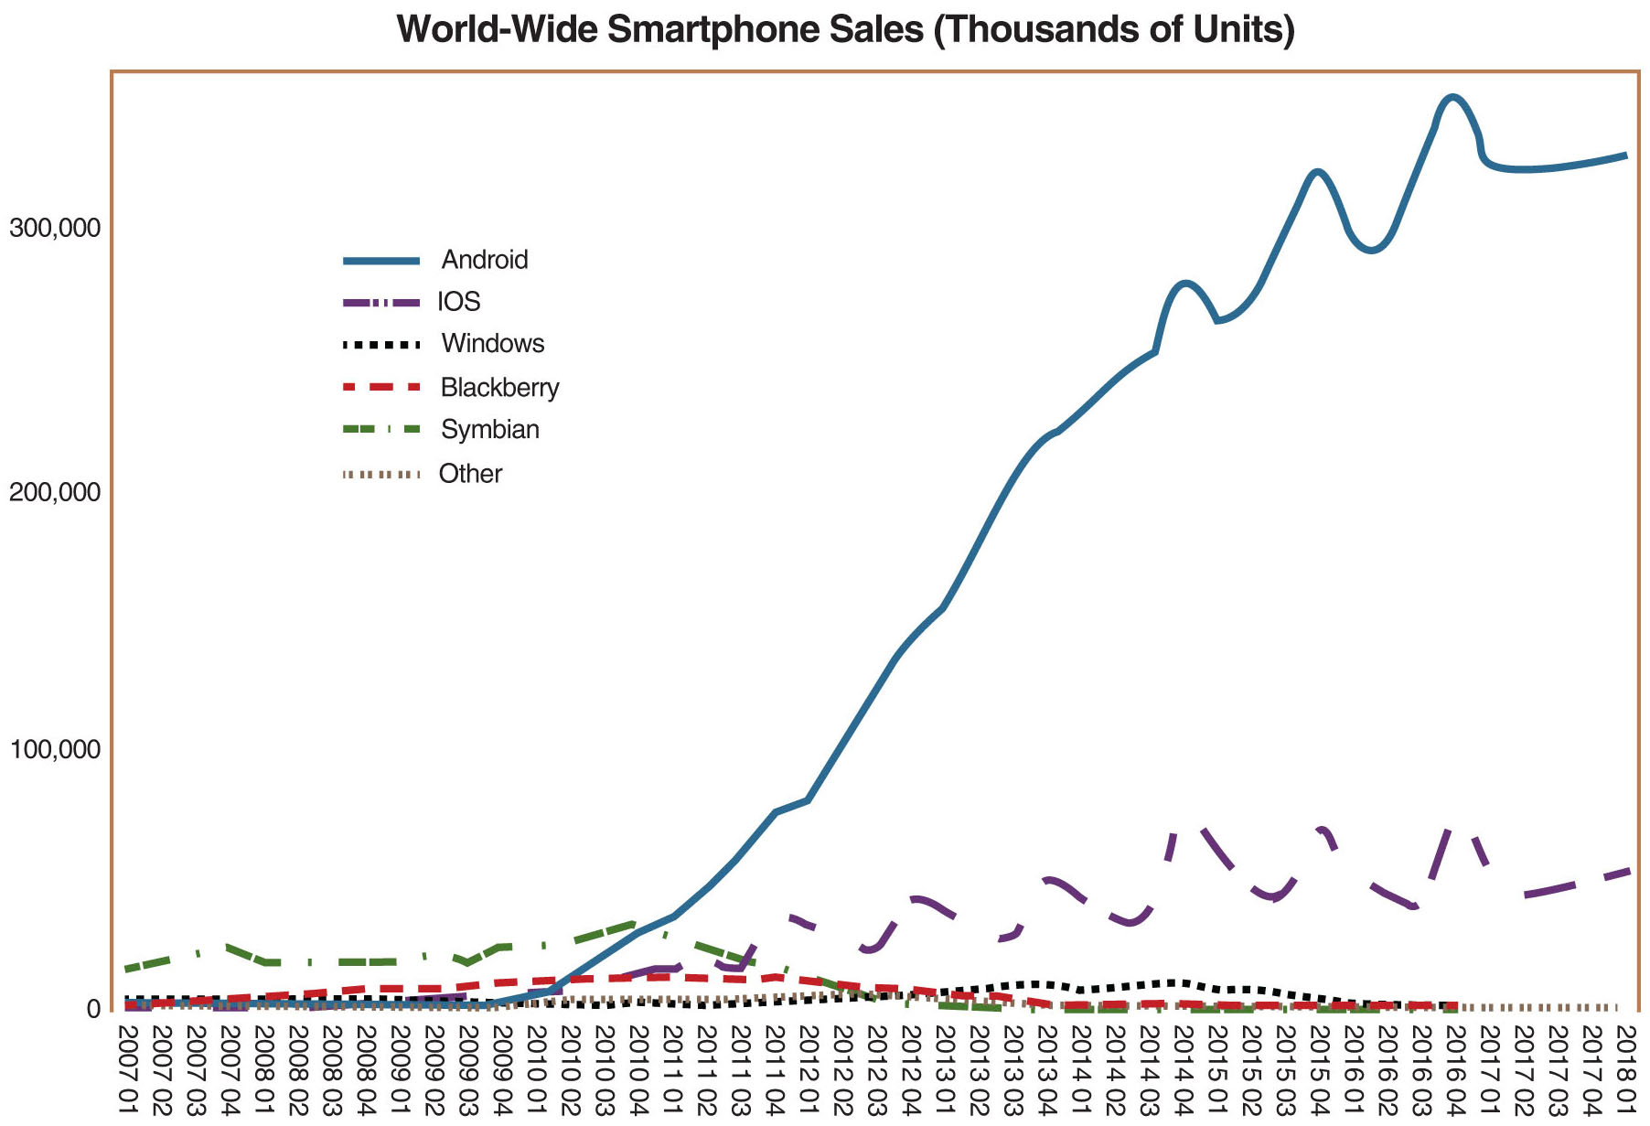
Since Then, Linux (and Android) Have Thrived
Smartmo
Notes:
Image from: http://upload.wikimedia.org/wikipedia/commons/8/83/World_Wide_Smartphone_Sales.png
Long Description:
The vertical axis represents values ranging from 0 to 300000 with intervals of 100000 and the horizontal axis represents Q 1 to Q 4 for the years 2007 to 2018 with intervals of 1. Sales of android were 0 in Q 1 2007. It increased gradually to 40000 around Q 4 2010. Then it increased drastically to 280000 around Q 4 2014 and then dropped to 250000 around Q 1 2015 then again increased to 350000 around Q 3 2015 and then again dropped to 295000 around Q 2 2016 and then again increased to 390000 around Q 4 2016 then again decreased to 350000 around Q 1 2017. Sales of i O S was 0 in Q 1 2007. It increased gradually to 20000 around Q 3 2011. Further from Q 4 2011 to Q 1 2018 there was an increased and decrease in sales in the range of 20000 to 80000. Sales of windows are around 0 from Q 1 2007 to Q 4 2016 with a slight increase up to 10000 around Q 1 2015. Sales of Blackberry are around 0 from Q 1 2007 to Q 4 2016 with a slight increase up to 15000 around Q 4 2010. Sales of Symbian is around 110000 from Q 1 2007 to Q 4 2010 which decreased gradually to 0 in Q 3 2012 and then remained constant. Sales of other smartphones were negligible throughout these years (approximate data).

Slide 18
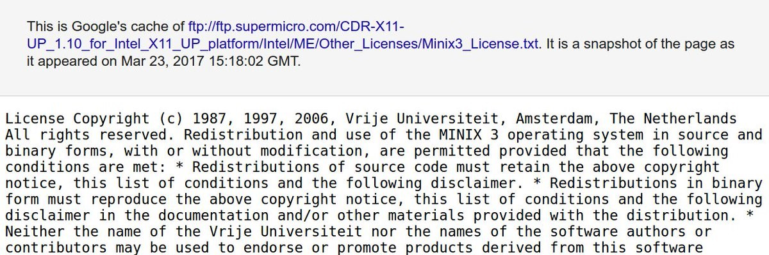
But So Has M I N I X
M I N I X 3 was adopted by Intel for its Management Engine and is now in desktops, servers & laptops
Notes:
By accident, people found that Intel had adopted MINIX in its Management Engine (a special subsystem in almost all Intel processors) that always runs if the motherboard is connected to power with low-level access to the devices of the system and the ability to bypass the O S completely. Even the researchers involved in the development of Minix 3 (including the authors of this book) were not aware that Intel had been using it for years in (almost) all of its C P U s.
Long Description:
The text reads as follows.This is Googles cache of F T P colon forward slash forward slash f t p dot supermicro dot com forward slash C D R hyphen X 1 1 hyphen U P under score, 1.10 under score 4 under score Intel under score X11 under score U P under score platform forward slash Intel forward slash M E forward slash other under score licenses forward slash minix 3 under score license dot T X T. It is a snapshot of the page as it appears on March 23, 2017, 18:02 GMT .Licensed copyright C in parenthesis 1987 1997 2006 Vrije Universiteit, Amsterdam, the Netherlands. All right reserved. Redistribution and use of the MINIX 3 operating system in source and binary form, with or without modification, are permitted, provided that the following conditions are met. Asterisk redistribution of source code must retain the above copyright notice, the list of conditions and the following disclaimer. Asterisk redistribution in binary form must reproduce the above copyright notice, this list of conditions and the following disclaimer in the documentation and forward slash or other materials provided with the distribution. Asterisk neither the name of the Virje Universiteit nor the names of the software authors or contributors may be used to endorse or promote products derived from this software.

Slide 19
Hardware

Slide 20
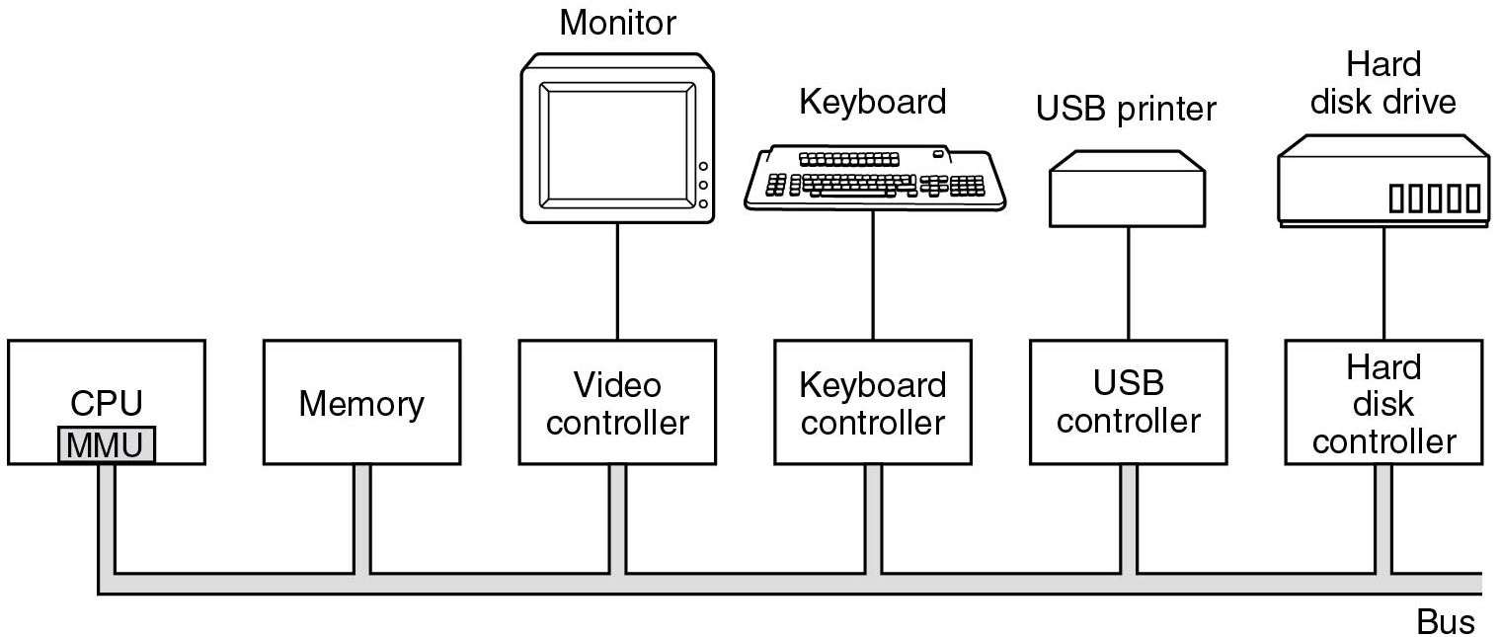
Processors (1)
Figure 1.6 Some of the components of a simple personal computer.
Notes:
Long Description:
Some of the components of a simple personal computer are shown. The CPU, memory, and I/O devices such as Video Controller, Keyboard Controller, USB Controller, and Hard disk Controller are all connected by a system bus and communicate with one another over it. The Monitor is connected to Video Controller, Keyboard is connected to Keyboard Controller, a USB printer is connected to USB Controller, and a Hard disk drive is connected to the Hard disk Controller.

Slide 21
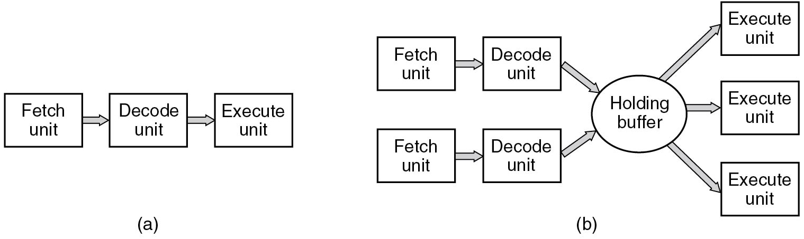
Processors (2)
Figure 1.7 (a) A three-stage pipeline. (b) A superscalar C P U.
Notes:
Long Description:
Part (a): It is labeled as a three-stage pipeline. There are three blocks connected with each other with a forward arrow. The first block is labeled Fetch unit, the second block is labeled Decode unit and the third block is labeled Execute unit. Part (b): It is labeled as Superscalar C P U. There are seven square-shaped blocks and an ellipse-shaped block at the center of the square-shaped blocks. The first two top blocks are labeled as Fetch unit and Decode unit. Similarly, the bottom two blocks are labeled as Fetch unit and Decode unit. In the center, the ellipse-shaped block is labeled Holding buffer. Both Fetch units are connected to both Decode units with arrows and similarly, both decode units are connected with Holding buffer with the forward arrows. The Holding buffer is connected with the other three blocks labeled Execute unit placed on the right of the Holding buffer block.

Slide 22
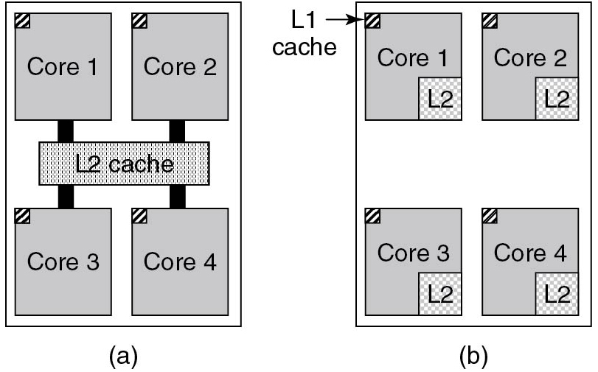
Memory (1)
Figure 1.8 (a) A quad-core chip with a shared L 2 cache. (b) A quad-core chip with separate L 2 caches.
Notes:
Long Description:
The image consists of two parts. Part (a): There are four square-shaped blocks labeled Core 1, Core 2, Core 3, and Core 4 placed at each corner inside a bigger square. There is a rectangle-shaped block labeled L2 cache placed between four blocks. All four blocks are connected with L 2 cache. Part (b): There are four square-shaped blocks labeled Core 1, Core 2, Core 3, and Core 4 placed at each corner inside a bigger square. The L 1 cache is placed in all four blocks in the top left corners of the blocks. The L 2 cache is placed in all four blocks in the lower right corners of the blocks. None of the blocks is connected.

Slide 23
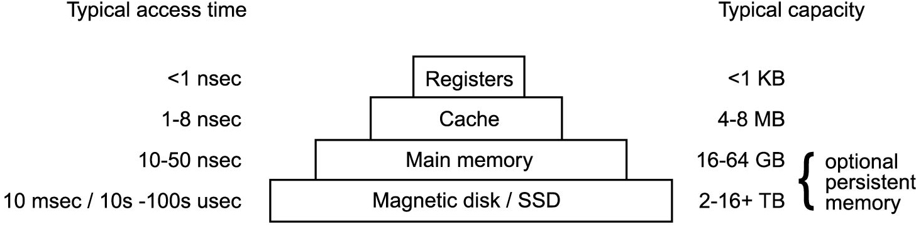
Memory (2)
Figure 1.9 A typical memory hierarchy. The numbers are very rough approximations.
Notes:
Long Description:
There are rectangular blocks placed one above the other labeled Registers, Cache, Main memory, and Magnetic disk / S S D from top to bottom. The smallest block labeled Registers is at the top. There are two types of information labeled Typical access time on the upper left and Typical capacity on the upper right. Part 1. On the left: less than 1 nanosecond. On the right: less than 1 Kilobytes. On the left: 1 to 8 nanoseconds. On the right: 4 to 8 Megabytes. On the left: 10 to 50 nanoseconds. On the right: 16 to 64 gigabytes. On the left: 10 milliseconds backslash 10 seconds to 100 micro seconds. On the right: 2 to 16 plus terabytes. The 16 to 64 gigabytes and 2 to 16 plus terabytes are categorized as optional persistent memory.

Slide 24
Memory (3)
Caching system issues:
When to put a new item into the cache.
Which cache line to put the new item in.
Which item to remove from the cache when a slot is needed.
Where to put a newly evicted item in the larger memory.
Notes:
Long Description:
There are rectangular blocks placed one above the other labeled Registers, Cache, Main memory, and Magnetic disk / S S D from top to bottom. The smallest block labeled Registers is at the top. There are two types of information labeled Typical access time on the upper left and Typical capacity on the upper right. Part 1. On the left: less than 1 nanosecond. On the right: less than 1 Kilobytes. On the left: 1 to 8 nanoseconds. On the right: 4 to 8 Megabytes. On the left: 10 to 50 nanoseconds. On the right: 16 to 64 gigabytes. On the left: 10 milliseconds backslash 10 seconds to 100 micro seconds. On the right: 2 to 16 plus terabytes. The 16 to 64 gigabytes and 2 to 16 plus terabytes are categorized as optional persistent memory.

Slide 25
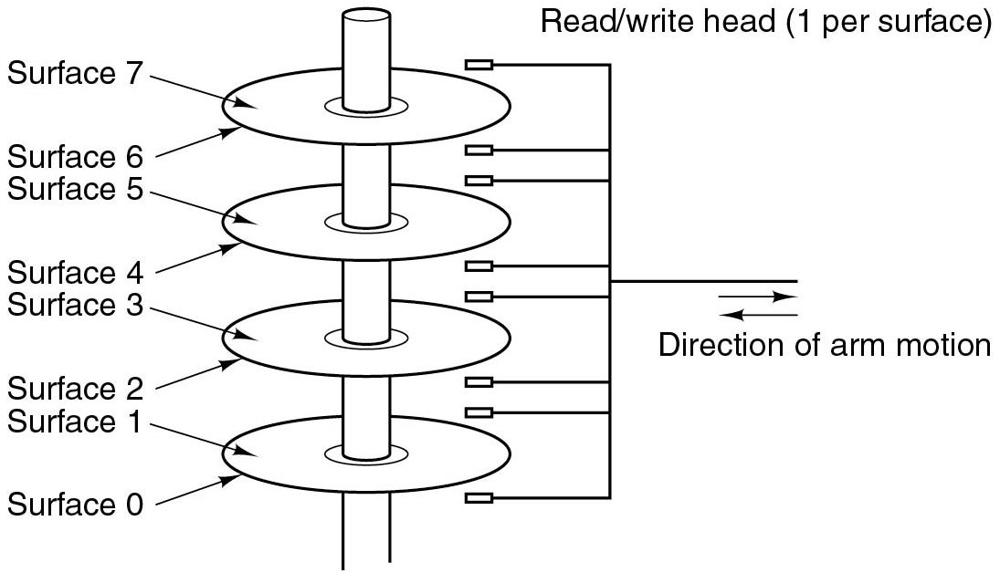
Nonvolatile Storage
Figure 1.10 Structure of a disk drive.
Notes:
Long Description:
A vertical round bar has four platters mounted on it. The upper and lower surface of the four platters arranged from top to bottom is labeled Surface 7 to Surface 0. The read or write head, depicted by a pair of parallel holders is also shown on the right of the bar. The direction of the arm motion is shown in a dual direction. Note: Read or write head [1 per surface].

Slide 26
Solid State Drives (S S D)
Often (incorrectly) referred to as disk also. No moving parts, data in electronic(flash) memory. Much faster than magnetic disks.
VikiVector/Shutterstock
We will discuss S S D s in more detail later.

Slide 27
I/O Devices (1)
Many types of I/O device.
Typically consist of 2 parts:
Controller
Chips that control device, receive commands from O S (e.g., to read data) Example: S A T A disk controller
Device itself
Generally simple interface (so S A T A controller can handle any S A T A disk)
Device driver: O S component that talks to controller
One for each type of device controller

Slide 28
I/O Devices (2)
Device driver communicates with controller via registers
Example: disk controller may have registers for
disk address,
memory address
sector count
direction (read or write)
Device registers are either accessed using special instructions (e.g., IN/OUT). or mapped in the O S’ address space (the addresses it can use).
The collection of device registers forms the I/O Port Space

Slide 29
I/O Devices (3)
To perform I/O:
Process executes system call
Kernel makes a call to driver
Driver starts I/O
and either polls device to see if it is done (busy waiting)
or asks device generate an interrupt when it is done (and returns)
more advanced: make use of special hardware – D M A (later)

Slide 30
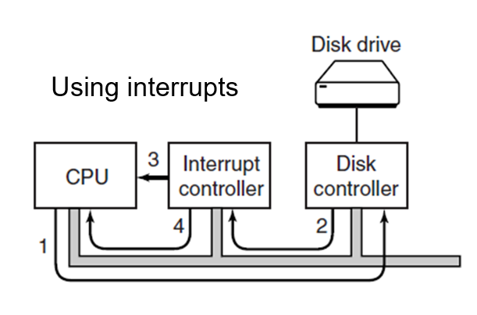
I/O Devices (4)
Figure 1.11 (a) The steps in starting an I/O device and getting an interrupt.
Notes:
Long Description:
The flow is as follows: Step 1: C P U to disk controller; step 2: disk controller to interrupt controller; step 3: a direct signal from interrupt controller to C P U; step 4: a curved signal from interrupt controller to C P U. Disk drive is above disk controller.

Slide 31
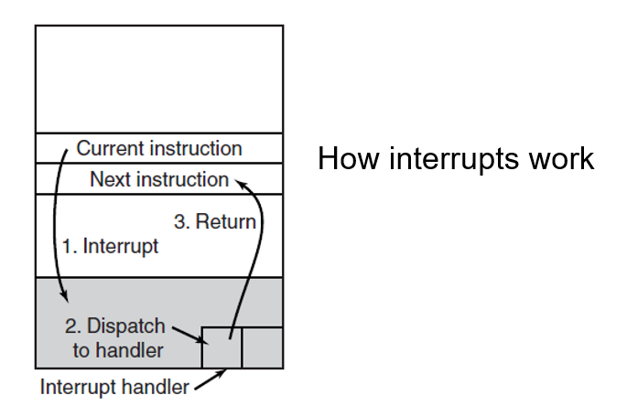
I/O Devices (5)
Figure 1.11 (b) Interrupt processing involves taking the interrupt, running the interrupt handler, and returning to the user program.
Notes:
Long Description:
Part (b): There is a vertical rectangular block labeled Interrupt handler with five partitions. The first partition from the top is empty. The second partition is labeled Current instruction. The third partition is labeled Next instruction. The fourth partition has labels 1. Interrupt and 3. Return. The fifth partition is labeled 2. Dispatch to the handler and highlighted. In the fifth partition, there is a small rectangle with one vertical partition is formed at the lower right end of the partition. An arrow labeled 1. Interrupt from Current instruction points to 2. Dispatch to handler. An arrow from 2. Dispatch to handler points to the interrupt handler. An arrow labeled 3. Return from the interrupt handler points to the third partition Next instruction.

Slide 32
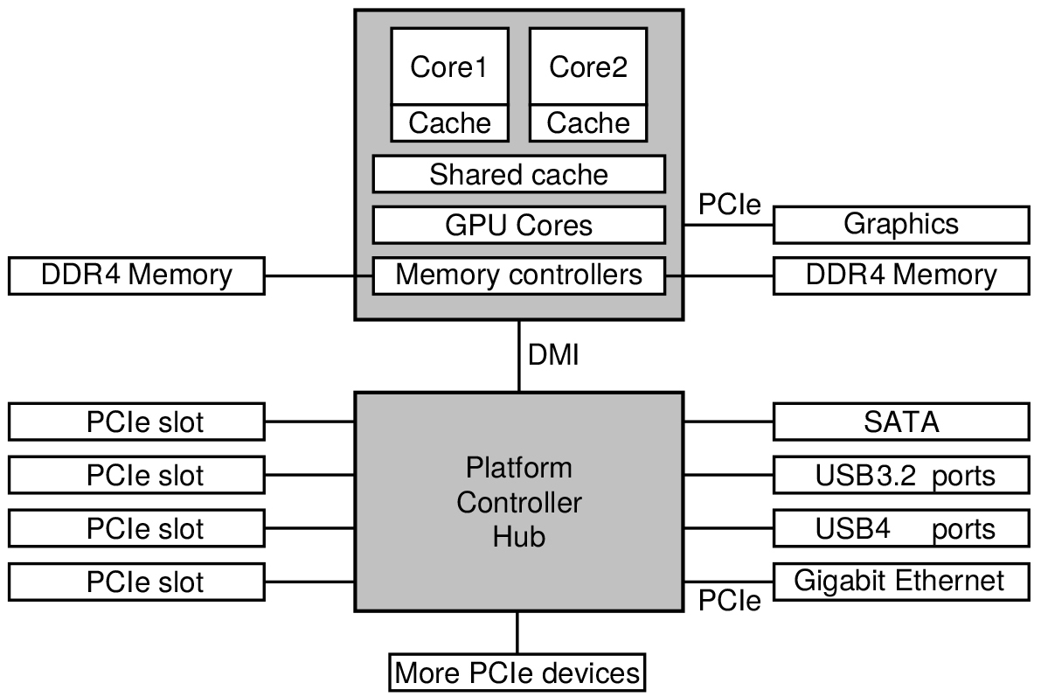
Buses
Figure 1.12 The structure of a large x 8 6 system: many buses (e.g., cache, memory, P C I e, U S B, S A T A, and D M I)
Notes:
Long Description:
The image has two square-shaped shaded blocks at the center, one above the other. Five rectangular blocks are on the left of the two blocks, and six rectangular blocks are on the right of the two blocks. Center: In the center, the first square-shaped block has a further two square-shaped blocks with two partitions placed on the upper left and upper right labeled Core 1 and Cache, Core 2 and Cache from top to bottom partitions. There are three rectangle-shaped blocks in the first square placed top to bottom labeled Shared Cache, G P U Cores, and Memory Controllers. The second square-shaped block labeled Platform Controller Hub is placed at the bottom of the first square and both squares are connected with each other labeled D M I. There is a rectangular block under the second square, connected with it and labeled More P C I e devices. Left: The first rectangular block labeled D D R 4 memory is connected to the first square. Four rectangular blocks labeled P C I e slot are connected to the second square. Right: Two rectangular blocks labeled Graphics, D D R 4 memory, are connected to the first square via P C I e. The four rectangular blocks labeled S A T A, U S B 3.2 ports, U S B 4 ports, Gigabit Ethernet, and connected to the second square. The Gigabit Ethernet is connected to the second square via P C I e.

Slide 33
Booting (U E F I)
Flash memory on motherboard contains firmware (a.k.a. B I O S)
After pressing power button, C P U executes B I O S which
Initializes R A M and other resources
Scans P C I/P C I e buses and initializes devices
Sets up the runtime firmware for critical services (e.g., low-level I/O) to be used by the system after booting
B I O S looks for location of partition table on second sector of boot device
Contains locations of other partitions
B I O S can read simple file systems (e.g., F A T-32), and starts first bootloader program (from partition indicated by U E F I boot manager)
The bootloader may load other bootloader programs
Eventually the O S is loaded.

Slide 34
The Operating System Zoo
Mainframe Operating Systems
Server Operating Systems
Personal Computer Operating Systems
Smartphone and Handheld Computer Operating Systems
The Internet of Things (I O T) and Embedded Operating Systems
Real-Time Operating Systems
Smart Card Operating Systems

Slide 35
What is an Operating System?
Extended Machine
Extending the hardware functionality
Abstraction over hardware
Hiding details from the programmer
Resource Manager
Protects simultaneous/unsafe usage of resources
Fair sharing of resources
Resource accounting/limiting

Slide 36
Operating System Concepts
O S offers functionality through system calls
Groups of system calls implement services
File System Service
Process Management Service
Processes are user-level abstractions to execute a program on behalf of a user
Each process has its own address space
Data involved in this processing is retrieved from/stored in files
Files persist over processes

Slide 37
Processes (1)
Key concept in all operating systems
Definition: a program in execution
Process is associated with an address space
Also associated with set of resources (registers, open files, alarms, etc.)
Process can be thought of as a container
Holds all information needed to run program

Slide 38
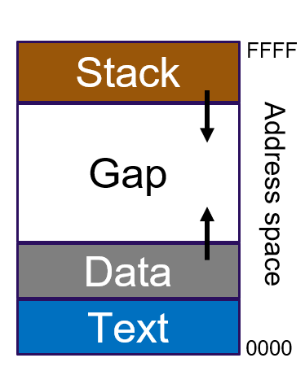
Processes (2)
Layout affected by:
Architecture
O S
Program
Very basic layout:
Stack: Active call data
Data: Program variables
Text: Program code

Slide 39
Processes (3)
Information about process is kept in the O S’ process table.
A suspended process consists of process table entry (saved registers and other info needed to restart the process) and its address space.
Process management:
Operations such as creating, terminating, pausing and resuming a processes
One process can create another process
Known as a child process
Creates a hierarchy (or “tree”) of processes

Slide 40
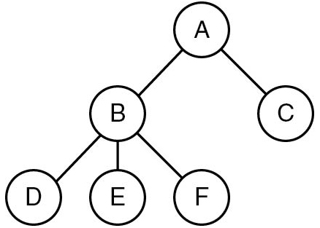
Processes (4)
Figure 1.13 A process tree. Process A created two child processes, B and C. Process B created three child processes, D, E, and F.
Notes:
Long Description:
Node "A" has two possibilities, B and C. B has three possibilities D, E, and F.

Slide 41
Processes (5)
Processes are “owned” by a user, identified by a U I D.
Every process typically has the U I D of the user who started it
On U N I X, a child process has the same U I D as its parent process
Users can be members of groups, identified by a G U I D
One process (superuser/root/administrator) is special: has more privileges

Slide 42
Files (1)
File: abstraction of (possibly) real storage device (e.g., disk)
You can read and write data from/to file by providing a position and an amount of data to transfer
Files are maintained in directories
A directory keeps an identifier for each file it contains
A directory is a file by itself
The U N I X philosophy: “Everything is a file”.

Slide 43
Files (2)
Directories and files form a hierarchy:
Hierarchy starts at root directory:
/
Files can be accessed through absolute paths:
/home/ast/todo-list
… or relative paths starting from the current working directory:
../courses/slides1.pdf
Other filesystems can be mounted into the root:
/mnt/windows
Filesystems mounting on Windows?

Slide 44
Files (3)
Files are “protected” by three bit tuples for owner, group and other users
Tuples contain a (r)ead, (w)rite and an e(x)ecute bit (but more bits are available)
Example:
-rwxr-x--x myuser my group 14492 Dec 4 18:04 my file
Owner is allowed to execute, modify, read the file
Group is allowed to read and execute the file
Other users are only allowed to execute the file
x bit for directories?

Slide 45
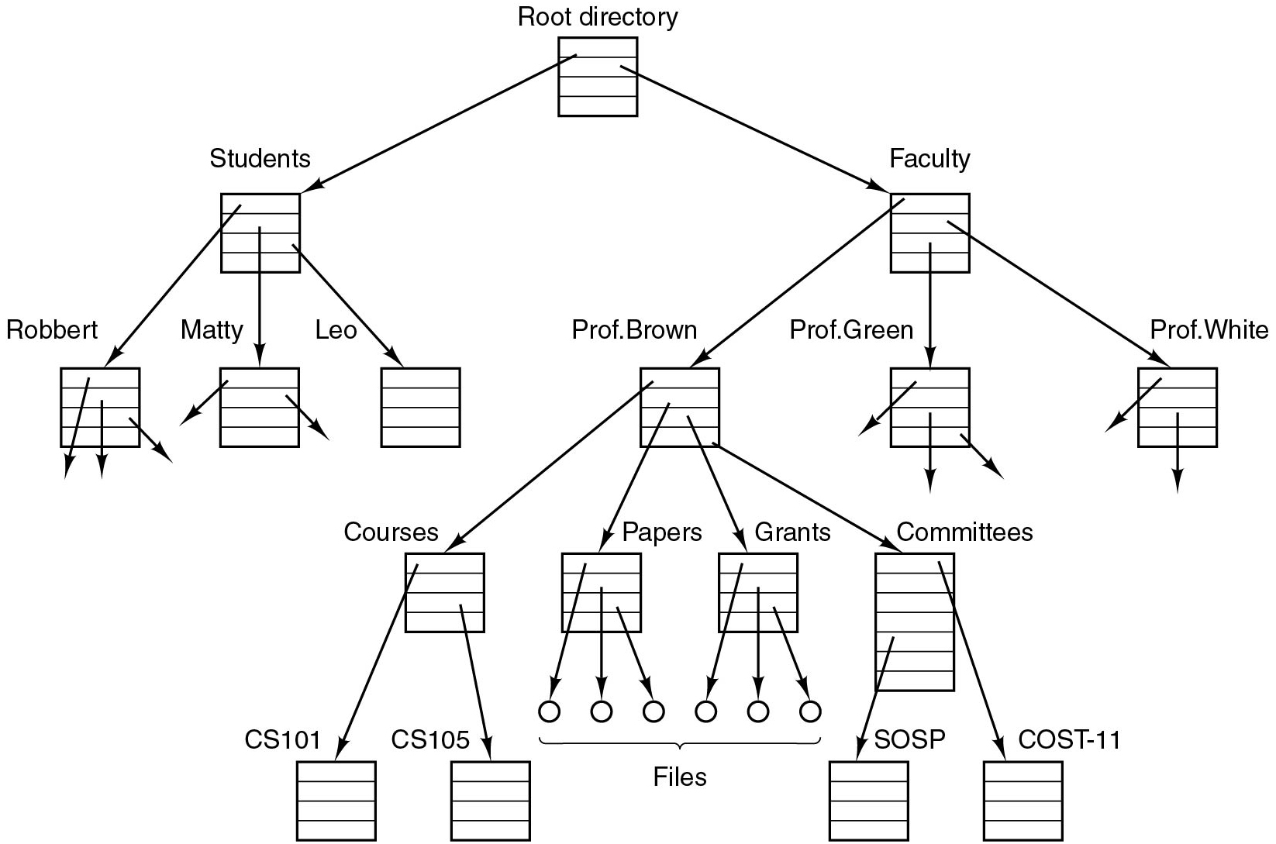
Files (4)
Figure 1.14 A file system for a university department.
Notes:
Hierarchical file systems were pioneered by Multics.
Long Description:
The tree starts at the root directory. Root directory has two possibilities Students and Faculty (children of the Root directory). Students have three possibilities Robbert, Matty, and Leo (grandchildren of the Root directory). The faculty has three possibilities Prof. Brown, Prof. Green, and Prof. White. Prof. Brown has four possibilities Courses, Papers, Grants, and Committees. Courses have two possibilities C S 101, C S 105. Papers and Grants have further infinite files. Committees have two possibilities S O S P and C O S T - 11.

Slide 46
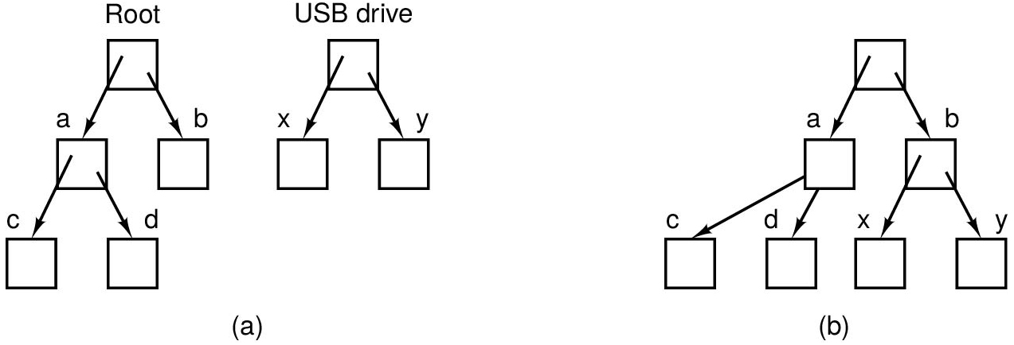
Files (5)
Figure 1.15 (a) Before mounting, the files on the U S B drive are not accessible. (b) After mounting, they are part of the file hierarchy.
Notes:
Long Description:
Part (a): The first tree starts at Root. Root has two possibilities "a" and b (children of Root). "a" has two possibilities c and d. The second tree starts at U S B drive. U S B drive has two possibilities x and y (children of U S B drive). Part (b): The tree starts at the empty node. Empty node has two possibilities "a" and b (children of Empty node). "a" has two possibilities c and d. b has two possibilities x and y.

Slide 47
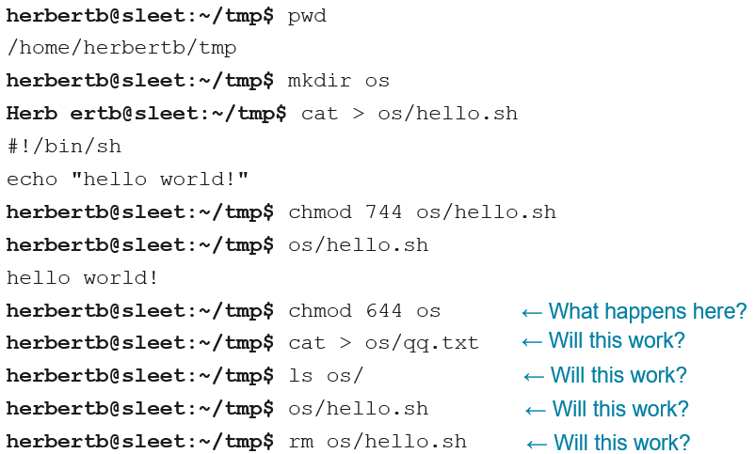
Files (6)
Quiz
Notes:
Long Description:
Herbert b at the rate sleet colon sleet colon tilde forward slash t m p dollar sign p w d. Forward slash home forward slash herbert b forward slash t m p. Herbert b at the rate sleet colon tilde forward slash t m p dollar sign m k d i r o s. Herb e r t b at the rate sleet colon sleet colon tilde forward slash t m p dollar sign cat right bracket os forward slash hello dot s h. Hashtag exclamation mark forward slash bin forward slash s h. Echo double quotation hello world exclamation mark double quotation. Herbert b at the rate sleet colon sleet colon tilde forward slash t m p dollar sign c h m o d 7 4 4 o s hello dot s h. Herbert b at the rate sleet colon sleet colon tilde forward slash t m p dollar sign o s forward slash hello dot s h. Hello world exclamation mark. Herbert b at the rate sleet colon sleet colon tilde forward slash t m p dollar sign c h m o d 6 4 4 left arrow what happens here question mark. Herbert b at the rate sleet colon sleet colon tilde forward slash t m p dollar sign cat right angle bracker o s forward slash q q dot t x t left headed arrow will this work question mark. Herbert b at the rate sleet colon sleet colon tilde forward slash t m p dollar sign l s o s forward slash left arrow will this work question mark. Herbert b at the rate sleet colon sleet colon tilde forward slash t m p dollar sign o s forward slash hello dot s h left arrow will this work question mark. Herbert b at the rate sleet colon sleet colon tilde forward slash t m p dollar sign r m o s forward slash hello dot s h left arrow will this work.

Slide 48
Files (7)
Special Files
“Everything is a file”:
Hardware devices are abstracted as files:
Block special files, e.g., disk:
brw-rw---- 1 root root 8, 2 Dec 4 18:04 /dev/sda2
Character special files, e.g., serial port:
crw-rw---- 1 root root 4,64 Dec 4 18:04 /dev/ttyS0
Other special files:
symbolic links
named/anonymous F I F O s (sockets/pipes)
“Everything is a file descriptor”

Slide 49
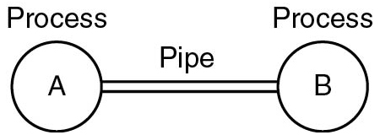
Files (8)
Pipes: pseudo files allowing for processes to communicate over a F I F O channel
Has to be set up in advance
Looks like a “normal” file to read and write from/to running processes
Figure 1.16 Two processes connected by a pipe.
Notes:
Long Description:
Two circles labeled "A" and B are connected by a pipe.

Slide 50
Files (9)
Terminology
Important terms
Path
Folder / map / directory
Root directory
Working directory
File descriptor
Mounting
Block/character special files
Pipe

Slide 51
Ontogeny Recapitulates Phylogeny
Each new “species” of computer
Goes through same development as “ancestors”
Consequence of impermanence
Text often looks at “obsolete” concepts
Changes in technology may bring them back
Happens with large memory, protection hardware, disks, virtual memory

Slide 52
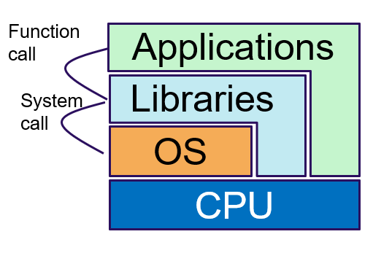
System Calls (1)
System calls are the interface the O S offers to applications to request services
Problem:
System call mechanism is highly operating system and hardware specific
The need for efficiency exacerbates this problem
Solution:
Encapsulate system calls in the C library (libc)
Typically exports 1 library call for each system call
U N I X libc based on the C P O S I X library
Note that many U N I X C libraries exist…
Notes:
Long Description:
From the top, applications is a large L structure. Libraries is a smaller L under it. O S is a small rectangle under libraries. C P U is a rectangle as a base. An arrow from applications to libraries is labeled as a function call. An arrow from libraries to O S is labeled as the system call.

Slide 53
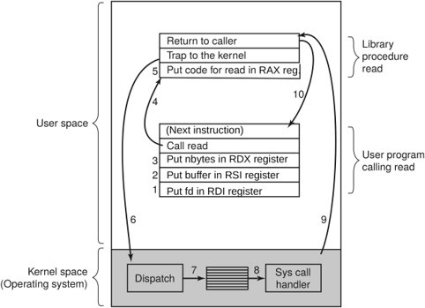
System Calls (2)
Figure 1.17 The 10 steps in making the system call read(fd, buffer, nbytes).
Notes:
Long Description:
A rectangular box has two partitions: The upper partition is labeled User Space, and the lower partition is labeled Kernel space (Operating system). The upper partition consists of Library procedure read and User program calling read. The Library procedure read has three sections labeled return to the caller, trap to the kernel, and Put code for reading in R A X reg. The User program calling read has five sections labeled (next instruction), call read, put n bytes in R D X register, Put buffer in R S I register, and Put f d in R D I register. Put n bytes in R D X register, Put buffer in R S I register, and Put f d in R D I register are labeled 3 to 1 respectively. Kernel space has three sections labeled Dispatch, the center section is marked with horizontal lines and the right section is labeled Syscall handler. An arrow labeled 7 from the first section connects the center section. Another arrow labeled 8 from the center section connects the right section. An arrow labeled 4 from call read points to put code for reading in R A X reg. An arrow labeled 6 from trap to kernel points to Dispatch. An arrow labeled 9 from the sys call handler to return to the caller. An arrow labeled 10 from the return to a caller that points to the next instruction.

Slide 54
System Calls for Process Management
Call | Description
p i d fork( ) | Create a child process identical to the parent
p i d waitp i d( pid, &statloc, options) | Wait for a child to terminate
s = execve(name, argv, environp) | Replace a process’ core image
exit(status) | Terminate process execution and return status
Figure 1.18 Some of the major P O S I X system calls. The return code s is −1 if an error has occurred. The return codes are as follows: p i d is a process id, f d is a file descriptor, n is a byte count, position is an offset within the file, and seconds is the elapsed time.

Slide 55
System Calls for File Management
Call | Description
f d = open(file, how, ...) | Open a file for reading, writing, or both
s = close(f d) | Close an open file
n = read(f d, buffer, nbytes) | Read data from a file into a buffer
n = write(f d, buffer, nbytes) | Write data from a buffer into a file
Position = Iseek(f d, offset, whence) | Move the file pointer
s = stat(name, &buf) | Get a file's status information
Figure 1.18 Some of the major P O S I X system calls. The return code s is −1 if an error has occurred. The return codes are as follows: p i d is a process id, f d is a file descriptor, n is a byte count, position is an offset within the file, and seconds is the elapsed time.

Slide 56
System Calls for File System Management
Call | Description
s = mkdir(name, mode) | Create a new directory
s = rmdir(name) | Remove an empty directory
s = link(name1 , name2) | Create a new entry, name2, pointing to name1
s = unlink(name) | Remove a directory entry
s = mount(special, name, flag) | Mount a file system
s = umount(special) | Unmount a file system
Figure 1.18 Some of the major P O S I X system calls. The return code s is −1 if an error has occurred. The return codes are as follows: p i d is a process id, f d is a file descriptor, n is a byte count, position is an offset within the file, and seconds is the elapsed time.

Slide 57
Miscellaneous System Calls
Call | Description
s = chdir(dirname) | Change the working directory
s = chmod(name,mode) | Change a file's protection bits
s = kill(pid,signal) | Send a signal to a process
s = time(&seconds) | Get the elapsed time since Jan. 1, 1970
Figure 1.18 Some of the major P O S I X system calls. The return code s is −1 if an error has occurred. The return codes are as follows: p i d is a process id, f d is a file descriptor, n is a byte count, position is an offset within the file, and seconds is the elapsed time.

Slide 58
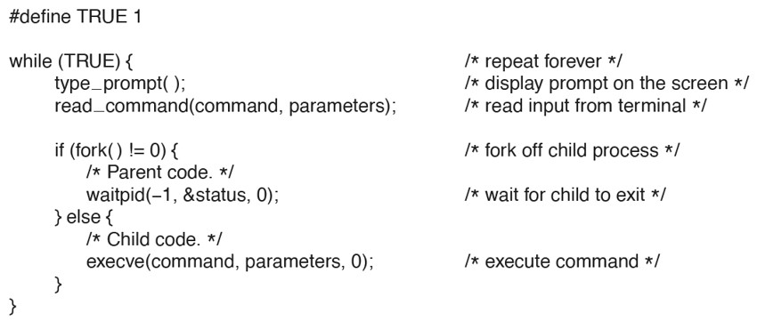
A Minimum Shell
Figure 1.19 A stripped-down shell. Throughout this book, TRUE is assumed to be defined as 1.
Notes:
Long Description:
The program code is as follows: # define TRUE 1 while (TRUE) Start Parenthesis. It has a comment repeat forever. type_prompt ( ) semicolon. It has a comment display prompt on the screen. read_command (command, parameters) semicolon. It has a comment read input from terminal. if (fork ( ) not equal to 0) Start Parenthesis. It has a comment fork off child process. Comment is parent code. wait pid (baseline equals 1, & status, 0) semicolon. It has a comment wait for child to exit. End Parenthesis else Start Parenthesis Comment is child node. execve (command, parameters, 0) semicolon. It has a comment execute command. End Parenthesis End Parenthesis

Slide 59
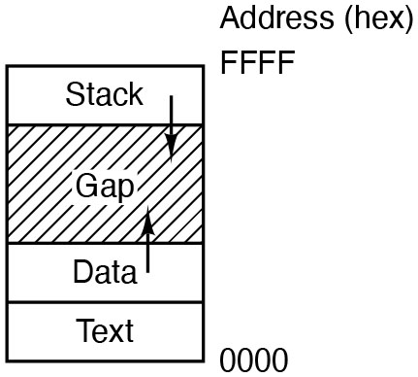
System Calls for Process Management
Figure 1.20. Processes have three segments: text, data, and stacks
Notes:
Long Description:
The rectangular block consists of four rows. The two rows at the lower end of the block are labeled Text and data from bottom to top. The two rows at the upper end are labeled Stack and Gap from top to bottom. The Gap row is highlighted with diagonal lines. The address of the block is labeled 0000 at the bottom and Address (hex) FFFF at the top. An arrow pointing downward is drawn at the uppermost row and an arrow pointing upward is drawn from the data row at the lower end.

Slide 60
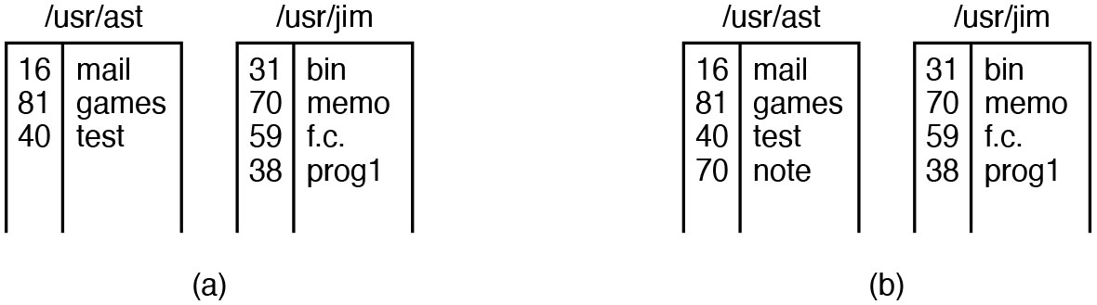
System Calls for Directory Management (1 of 2)
Figure 1.21. (a) Two directories before linking usr/jim/memo to ast’s directory. (b) The same directories after linking.
Notes:
Long Description:
Part (a): There are two tables. The first table labeled /u s r/ a s t/ with three rows and two columns. Row 1: Column 1: 16, Column 2: mail. Row 2: Column 1: 81, Column 2: games. Row 3: Column 1: 40, Column 2: test. The second table labeled /u s r/ j i m/ with four rows and two columns. Row 1: Column 1: 31, Column 2: bin. Row 2: Column 1: 70, Column 2: memo. Row 3: Column 1: 59, Column 2: f.c. Row 4: Column 1: 38, Column 2: prog 1. Part (b): It has the same two tables as in part (a) only with the addition of the fourth row in the first table. Row 4: Column 1: 70, Column 2: note.

Slide 61
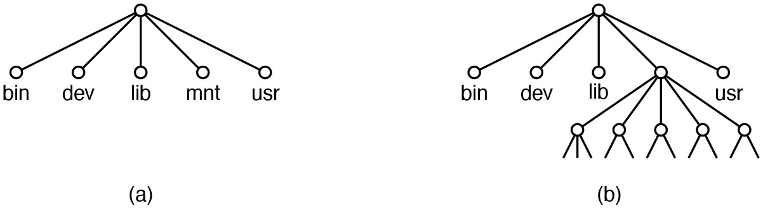
System Calls for Directory Management (2 of 2)
Figure 1.22. (a) File system before the mount. (b) File system after the mount.
Notes:
Long Description:
Part (a): There are five nodes labeled bin, dev, lib, m n t, and u s r are connected to an empty node in the form of a tree. Part (b): There are five nodes labeled bin, dev, lib, empty node and u s r are connected to an empty node in the form of a tree. The fourth empty node has a further five nodes that are further connected to many nodes.

Slide 62
The Windows A P I (1)
UNIX | Win32 | Description
fork | CreateProcess | Create a new process
waitpid | WaitForSingIeObject | Can wait for a process to exit
execve | (none) | Createprocess = fork + execve
exit | ExitProcess | Terminate execution
open | createFile | Create a file or open an existing file
close | CloseHandIe | Close a file
read | ReadFile | Read data from a tile
Write | WriteFile | Write data to a file
I seek | SetFilePointer | Move the file pointer
stat | GetFileAttributesEx | Get various file attributes
mkdir | CreateDirectory | Create a new directory
Figure 1.23 The Win32 A P I calls that roughly correspond to the U N I X calls of Fig. 1.18.

Slide 63
The Windows A P I (2)
UNIX | Win32 | Description
Iseek | SetFilePointer | Move the tile pointer
stat | GetFileAttributesEx | Get various file attributes
mkdir | CreateDirectory | Create a new directory
rmdjr | RemoveDirectory | Remove an empty directory
link | (none) | Win32 does not support links
unlink | DeleteFile | Destroy an existing file
mount | (none) | Win32 does not support mount
umount | (none) | Win32 does not support mount, so no umount
chdir | SetCurrentDirectory | Change the current working directory
chmod | (none) | Win32 does not support security (although N T does)
kill | (none) | Win32 does not support signals
time | GetLocamme | Get the current time
Figure 1.23 The Win32 A P I calls that roughly correspond to the U N I X calls of Fig. 1.18.

Slide 64
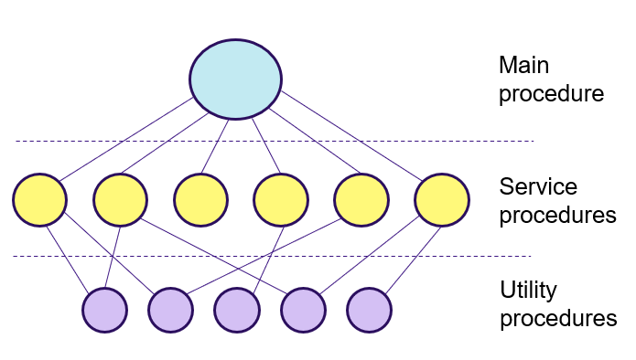
O S Structure: Monolithic (1 of 3)
Main program invokes requested system calls
Kernel is monolithic block with:
Service procedures that carry out the system calls
Utility procedures that help implement service procedures
Notes:
Long Description:
There are three tiers of image. The first tier labeled Main procedure has one node. The second tier labeled Service procedure has six nodes connected to the first node of the first tier. The third tier labeled Utility procedures has five nodes. The first two nodes of the third tier are connected to the first node of the second tier. The first node of the third tier is connected to the second node of the second tier. The second node of the third tier is connected to the fifth node of the second tier. The third node of the third tier is connected to the fourth and sixth node of the second tier. The fourth node of the third tier is connected to the second node of the second tier. The fifth node of the third tier is connected to the sixth node of the second tier.

Slide 65
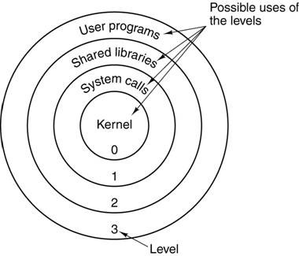
O S Structure: Monolithic (2 of 3)
Monolithic kernels separate applications and O S using 2 privilege levels:
User (ring 3)
Kernel (ring 0)
4 privilege levels are available on x 8 6
Only early layered systems (e.g., Multics) used more than 2 levels in practice.
Notes:
Long Description:
0, 1, 2, 3 are labeled as level and kernel, system calls, shared libraries, and user programs are labeled as the possible uses of the level.

Slide 66
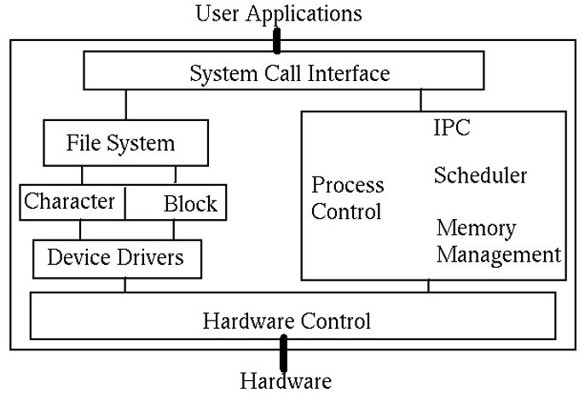
O S Structure: Monolithic (3 of 3)
Typical U N I X structure
Notes:
Long Description:
The rectangular structure consists of the following from top to bottom. User application, system call interface, file system and process control, hardware control, and hardware. The system call interface is divided into the file system and process control. The file system is divided into character and block, then device drivers. Process control consists of I P C, scheduler, and memory management.

Slide 67
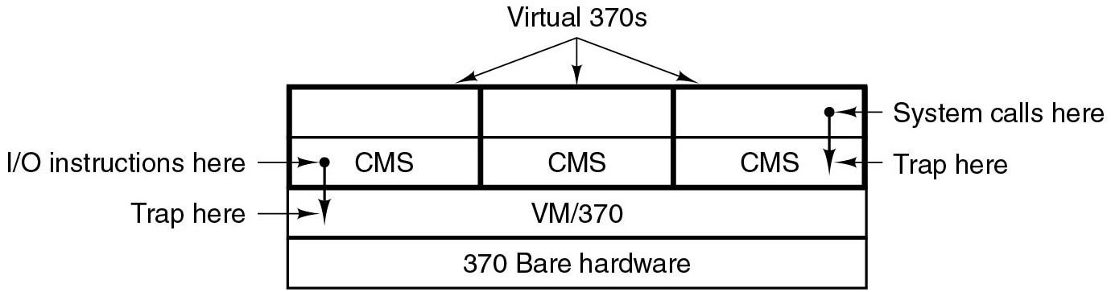
O S Structure: Virtualization (1 of 2)
Invented in the 70s to separate multiprogramming from extended machine
Revamped today in several domains
N independent O S system call interfaces
Figure 1.28 The structure of V M/370 with C M S.
Notes:
Long Description:
There is a rectangular block with four partitions. There are further three vertical partitions in the first two partitions. The first partition is empty and categorized as System calls here with a forward arrow pointing toward the partition. The second partition with three partitions labeled C M S is categorized as Trap here with a forward arrow at the right side and I/O instructions here with a forward arrow on left. The three vertical partitions are categorized as Virtual 370 s. The third horizontal partition is labeled V M/370 and is categorized as Trap here with a forward arrow pointing toward the partition. There is a downward arrow from both forward arrows from both sides. The fourth partition is labeled 370 Bare hardware.

Slide 68
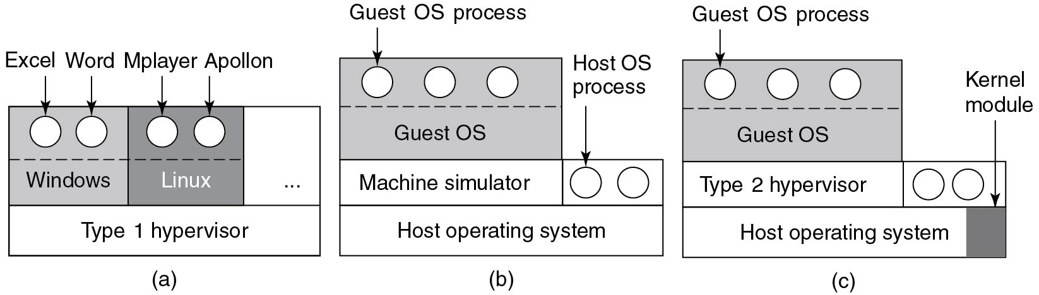
O S structure: Virtualization (2 of 2)
Virtual machine monitor (V M M) or Hypervisor emulates hardware
Type 1: V M M runs on bare metal (e.g., Xen)
Type 2: V M M hosted in the O S (e.g., Q E M U)
Hybrid: V M M inside the O S (e.g., K V M)
Alternative: para-virtualization (discussed later)
Figure 1.29 (a) A type 1 hypervisor. (b) A pure type 2 hypervisor. (c) A practical type 2 hypervisor
Notes:
Long Description:
Part (a): There is a rectangle-shaped block with three vertical partitions and a horizontal partition. The three vertical partitions are further partitioned with a horizontal line. The first partition is labeled Windows, the second partition is labeled Linux, and the third partition is marked with epsilon. The first two vertical partitions have two circles in each labeled Excel, Word, Mplayer, and Apollon. The horizontal partition is labeled Type 1 hypervisor. Part (b): There is a rectangle-shaped block with one vertical partition and two horizontal partitions. The vertical partition is further partitioned with a horizontal line. The first vertical partition has three circles and each labeled Guest O S process. The second horizontal partition is further partitioned. The left side partition is labeled Machine Simulator. The right side partition has two circles labeled Host O S process. The third horizontal partition is labeled Host operating system. Part (c): There is a rectangle-shaped block with one vertical partition and two horizontal partitions. The vertical partition is further partitioned with a horizontal line. The first vertical partition has three circles and each labeled Guest O S process. The second horizontal partition is further partitioned. The left side partition is labeled Type 2 hypervisor. The right side partition has two circles. The third horizontal partition is labeled Host operating system and the further vertical highlighted partition is labeled Kernel module.

Slide 69
Containers
Containers can run multiple instances of an O S on a single machine
Each container shares the host O S kernel and the binaries and libraries
Container does not contain full O S and therefore can be lightweight
Downsides to containers
Cannot run a container with a completely different O S than the host
Unlike with virtual machines no strict resource partitioning
Containers are process-level isolated
If a container alters the stability of the underlying kernel this may affect other containers

Slide 70
O S Structure: Exokernel
Idea: Separate resource control from extended machine
Similar to a V M M/Hypervisor, but:
Exokernel does not emulate hardware
Provides only safe low-level resource sharing
Service procedures are offered as a library directly
linked to the application
Library O S
System calls...?
Different library O Ses for different programs
Allows application-level O S specialization

Slide 71
O S Structure: Unikernel
Modern incarnation of LibO S
Just enough functionality to support a single application (e.g., Web server)
Often on top of V M
Only one application on V M
All code can run in kernel mode

Slide 72
O S Structure: Microkernel-based Client/Server (1 of 3)
Organize service procedures in programs that run in separate
processes
System Servers/Drivers
System processes communicate via message passing
System calls rely on the same messaging mechanism
Messaging mechanism implemented in minimal kernel
Microkernel

Slide 73
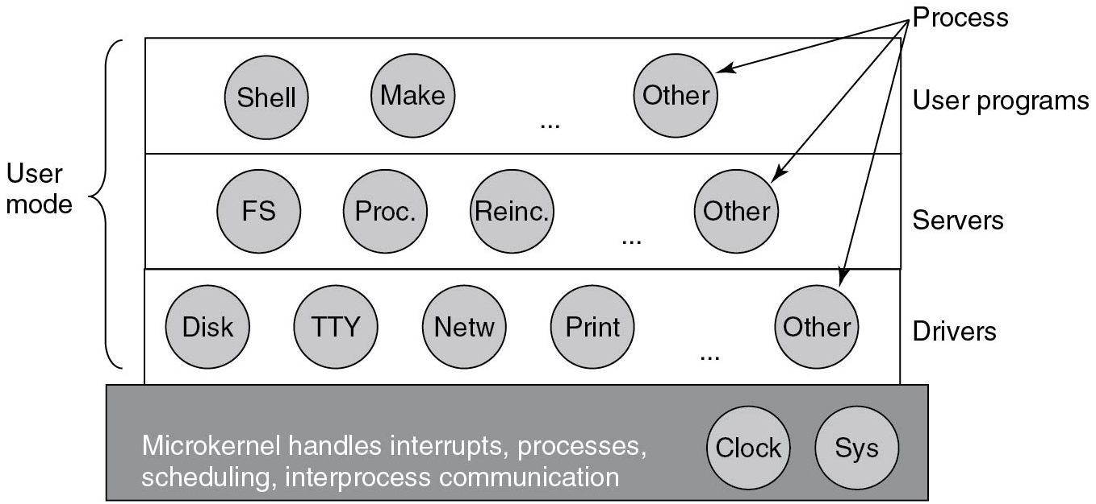
O S Structure: Microkernel-based Client/Server (2 of 3)
Figure 1.26 Simplified structure of the M I N I X system
Notes:
Long Description:
There is a rectangular block with four partitions. The top first partition is labeled User Programs with three circles labeled Shell, Make, and Others. The top second partition is labeled Servers with four circles labeled F S, Proc., Reinc., and Others. The top third partition is labeled Drivers with five circles labeled Disk, T T Y, Netw, Print, and Others. The others in all above partitions are marked as Process. The first three partitions are categorized as User mode. The last fourth partition has two circles labeled Clock and Sys on the lower right end. Note on the fourth partition: Microkernel handles interrupts, processes, scheduling, inter processes communication.

Slide 74
O S Structure: Microkernel-based Client/Server (3 of 3)
Important advantage: easier to adhere to Principle of Least Authority (P O L A):
Relatively small Trusted Computing Base (T C B)
Each O S process allowed to do only what is needed to perform its task
Compromise of, say, the printer driver will not affect rest of the O S
Disadvantage
Message passing is slower than a function call (as in a monolithic kernel)

Slide 75
The World According to C
C was created by Dennis Ritchie in 1972 to develop U N I X programs
Some of the U N I X roots still visible
“Everything is a file”

Slide 76
U N I X: Everything Is a File
Sockets
Devices
Hard drives
Printers
Modems
Pipes

Slide 77
C: Everything Is a File
Descriptive Name | Short Name | File Number | Description
Standard In | stdin | 0 | Input from the keyboard
Standard Out | stdout | 1 | Output to the console
Standard Error | stderr | 2 | Error output to the console
Default every process starts with 3 “files” opened

Slide 78
Hello World? (1 of 3)
What do we have to do to print “Hello World” on the console (Standard output)?
printf(char *str, …);

Slide 79
Hello World! (1 of 3)
#include <stdio.h> int main(int argc, char **argv) { printf("Hello World!\n"); return 0; }

Slide 80
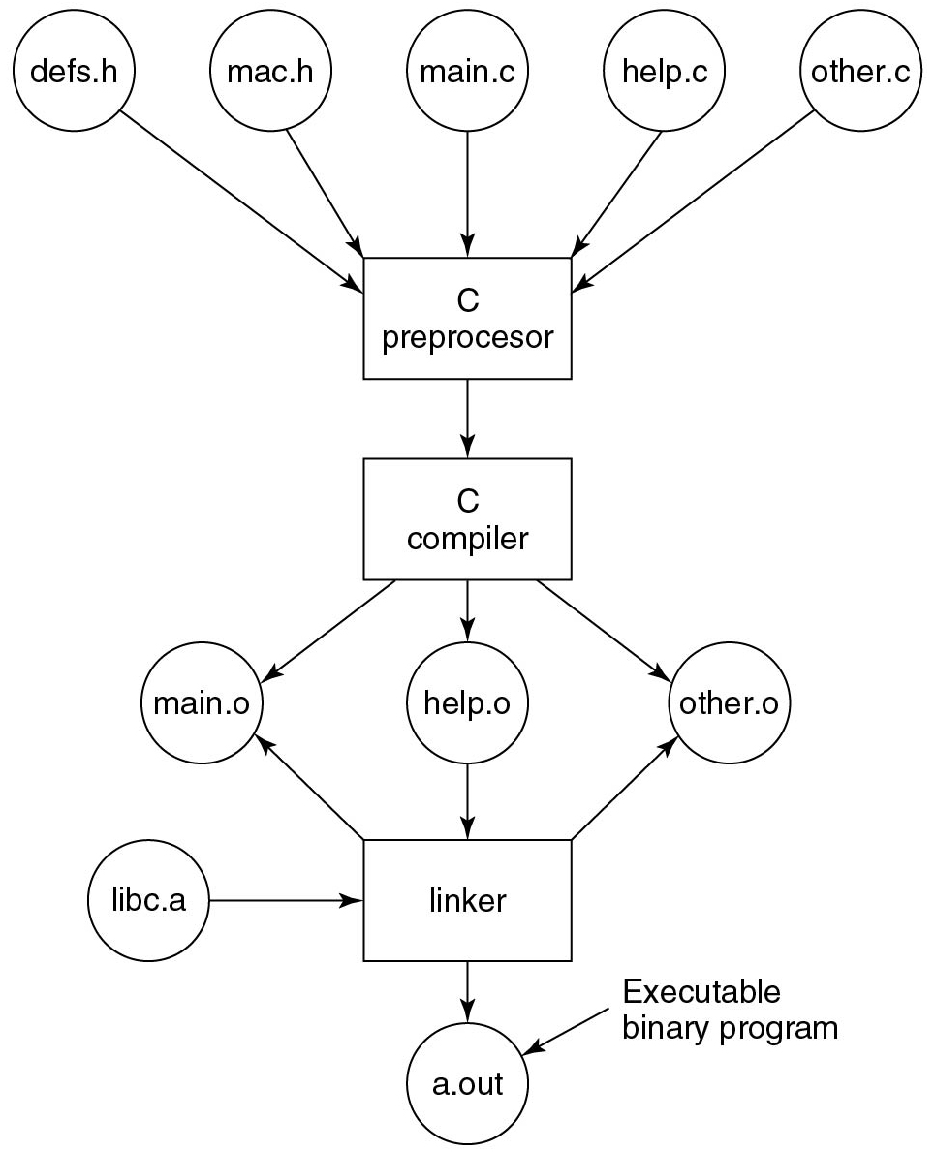
Build Process
Figure 1.30 The process of compiling C and header files to make an executable binary program.
Notes:
Long Description:
The flowchart has five circles with forwarding arrows. The five circles are labeled defs.h, mac.h, main.c, help.c, and other.c. All forwarding arrows point to a rectangular block labeled C Processor. An arrow from the rectangle points to a rectangular block labeled C Compiler. There are three arrows pointing to further three circles labeled main.o, help.o, and other.o. From help.o, there is a forward arrow that points to a rectangle-shaped block labeled linker. From the linker, a forward arrow points to a circle labeled a.out and categorized as Executable Binary Program. From the linker, there are two backward arrows points to main.o and other.o. There is a circle labeled libc.a and a forward arrow points to the linker.

Slide 81
Hello World? (2 of 3)
What do we have to do to print “Hello World” on the console (Standard output)?
printf(char *str, …);
int write(int fd, char *buf, size_t len);

Slide 82
Recall: Everything Is a File!
Default every process starts with 3 “files” opened
Descriptive Name | Short Name | File Number | Description
Standard In | stdin | 0 | Input from the keyboard
Standard Out | stdout | 1 | Output to the console
Standard Error | stderr | 2 | Error output to the console

Slide 83
Hello World! (2 of 3)
#include <unistd.h> #define STDOUT 1 int main(int argc, char **argv) { char msg[] = "Hello World!\n"; write(STDOUT, msg, sizeof(msg));
return 0; }

Slide 84
Hello World? (3 of 3)
What do we have to do to print “Hello World” on the console (Standard output)?
printf(char *str, …);
int write(int fd, char *buf, size_t len);
int syscall(int number, ...);

Slide 85
Hello World! (3 of 3)
#define _G N U_SOURCE #include <sys/syscall.h> #define STDOUT 1
int main(int argc, char **argv) { char msg[] = "Hello World!\n";
int nr = SYS_write; syscall(nr, STDOUT, msg, sizeof(msg)); return 0; }

Slide 86
Standard Library
Libc provides useful wrappers around syscalls
E.g., write, read, exit
Need to call the syscall or int 0x80 instruction
Done in assembly (inline, or separate object)
syscall(int nr, …)

Slide 87
System All on x 8 6: Difference Between 3 2 b and 6 4 b

Slide 88
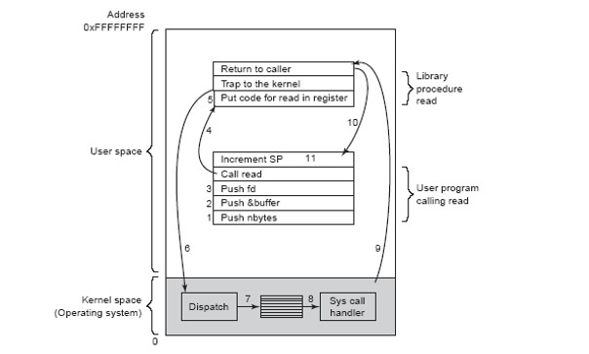
System Calls: Internals (x86, 32b)
1-4: Prepare, and call library routine read(fd, buffer, nbytes).
5-6: Prepare, and switch to kernel
7-9: Lookup & sys, handler, and return to user mode
10-11: Return to program and pop the stack
Notes:
Long Description:
The rectangle is divided into two parts labeled user space and kernel space or operating system. The user space has two parts labeled library procedure read and user program calling read. Library procedure read consists of three stacked rectangles labeled return to the caller, trap to the kernel, and put code for read in the register or 5, respectively. The user program calling read consists of five rectangles labeled increment S O, call read, push f d or 3, push and buffer or 2, and push n bytes or 1 respectively. The kernel space consists of three rectangles placed in a row labeled dispatch, a rectangle with horizontal lines, and a sys call handler. The arrows are labeled as follows. From call read to put code for read in the register, 4. From return to caller to increment S P, 10. From sys call handler to return to caller, 9. From trap to the kernel to dispatch, 6. From dispatch to sys call handler via the rectangular structure, 7 and 9.

Slide 89
Linux System Calls (x86, 32b)
System call is triggered by special instruction (e.g., int 0x80)
Privilege level is changed to kernel mode
Program counter is set to specific location
Arguments for system call are passed in registers:
eax
syscall number
other general purpose registers are used for arguments: e b x, e c x, e d x, e s i, e d i, e b p
Additional arguments on stack

Slide 90
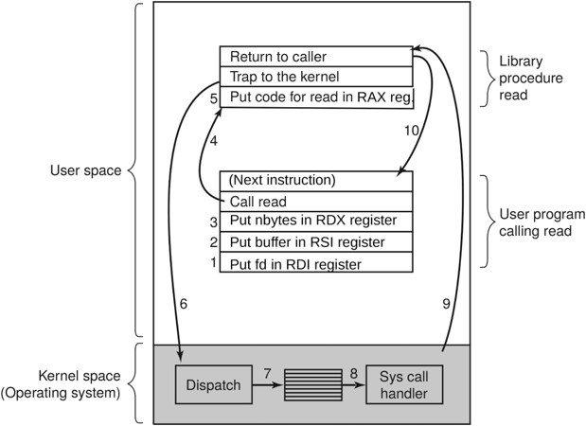
Linux System Calls (x86-64)
Supports legacy x86-style int 0x80
Uses old calling convention
New instruction: syscall
Arguments for syscall passed in registers:
rax
syscall number
(different from 32-bit x86)
other general purpose registers used for arguments: rdi, rsi, rdx, r10, r8, r9
Notes:
Long Description:
A rectangular box has two partitions: The upper partition is labeled User Space, and the lower partition is labeled Kernel space (Operating system). The upper partition consists of Library procedure read and User program calling read. The Library procedure read has three sections labeled return to the caller, trap to the kernel, and Put code for reading in R A X reg. The User program calling read has five sections labeled (next instruction), call read, put n bytes in R D X register, Put buffer in R S I register, and Put fd in R D I register. Put n bytes in R D X register, Put buffer in R S I register, and Put fd in R D I register are labeled 3 to 1 respectively. Kernel space has three sections labeled Dispatch, the center section is marked with horizontal lines and the right section is labeled Syscall handler. An arrow labeled 7 from the first section connects the center section. Another arrow labeled 8 from the center section connects the right section. An arrow labeled 4 from call read points to put code for reading in R A X reg. An arrow labeled 6 from trap to kernel points to Dispatch. An arrow labeled 9 from the sys call handler to return to the caller. An arrow labeled 10 from the return to a caller that points to the next instruction.

Slide 91
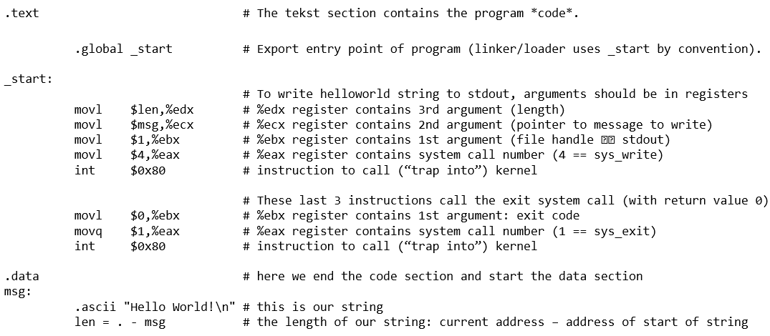
Hello World! (Linux, x86)
Notes:
Long Description:
The code from top to bottom are as follows.
dot text hashtag the tekst section contains the program double quotation code double quotation.
dot global underscore start hashtag export entry point of program left parentheses linker forward slash loader uses underscore start by convention right parenthesis.
underscore start colon
hashtag to write hello world string to s t d o u t, arguments should be in registers
m o v l dollar sign l e n comma percentage e d x hashtag percentage e d x register contains a third argument, right parenthesis, length, left parenthesis.
m o v l dollar sign m s g comma percentage e c x hashtag percentage e c x register contains the second argument left parenthesis pointer to measure message to write right parenthesis.
m o v l dollar sign 1 comma percentage e b x hashtag percentage e b x register contains the first argument left parenthesis file handle right arrow s t d out
m o v l dollar sign 4 comma percentage e a x hashtag percentage e a x register contains system call number left parenthesis 4 double equals s y s underscore write
i n t dollar 0 x 80 hashtag instruction to call left parenthesis double quotation trap into double quotation right parenthesis kernel
hashtag these last 3 instructions call the exit system call left parenthesis with return value 0 right parenthesis
m o v l dollar sign 0 comma percentage e b x hashtag percentage e b x register contains first argument colon exit code
m o v q dollar sign 1 comma percentage e a x hashtag percentage e a x register contains system call number left parenthesis 1 double equals sys underscore exit right parenthesis
i n t dollar sign 0 x 80 hashtag instruction to call left parenthesis double quotation trap into double quotation right parenthesis kernel
dot data hashtag here we end the code section and start the data section
m s g colon
dot a s c i i double quotation hello world exclamation mark backward slash n double quotation hashtag this is our string
l e n equals dot hyphen m s g hashtag the length of out string colon current address hyphen address of start of string

Slide 92
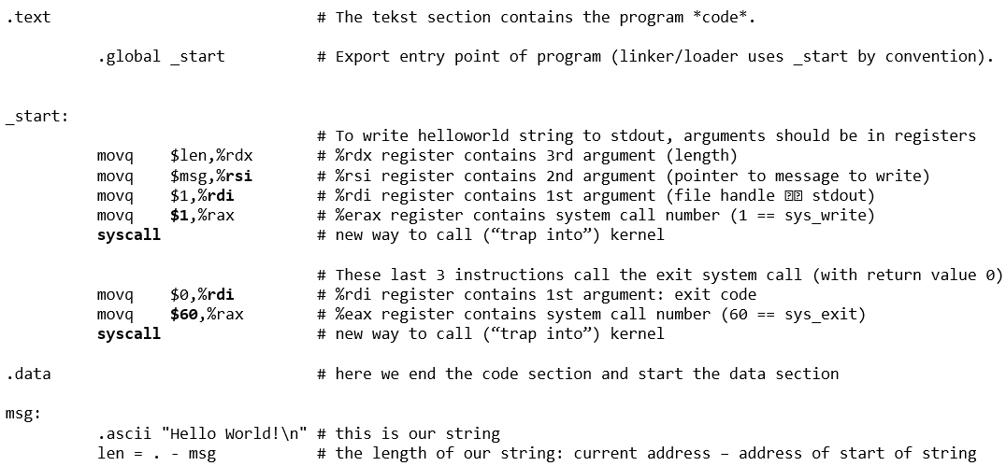
Hello World! (Linux, x86-64)
Notes:
Long Description:
The code lines from top to bottom are as follows.
dot text hashtag the tekst section contains the program asterisk code asterisk.
dot global underscore start hashtag export entry point of program left parentheses linker forward slash loader uses underscore start by convention right parenthesis.
underscore start colon
hashtag to write hello world string to s t d o u t, arguments should be in registers
m o v q dollar sign l e n comma percentage r d x hashtag percentage r d x register contains a third argument, right parenthesis, length, left parenthesis.
m o v q dollar sign m s g comma percentage r s i hashtag percentage r s i register contains the second argument left parenthesis pointer to measure message to write right parenthesis.
m o v q dollar sign 1 comma percentage r d i hashtag percentage r d i register contains the first argument left parenthesis file handle right arrow s t d out
m o v q dollar sign 1 comma percentage r a x hashtag percentage e r a x register contains system call number left parenthesis 1 double equals s y s underscore write
s y s call hashtag instruction to call left parenthesis double quotation trap into double quotation right parenthesis kernel
hashtag these last 3 instructions call the exit system call left parenthesis with return value 0 right parenthesis
m o v q dollar sign 0 comma percentage r d i hashtag percentage r d i register contains first argument colon exit code
m o v q dollar sign 60 comma percentage r a x hashtag percentage e a x register contains system call number left parenthesis 60 double equals sys underscore exit right parenthesis
s ys call hashtag instruction to call left parenthesis double quotation trap into double quotation right parenthesis kernel
dot data hashtag here we end the code section and start the data section
m s g colon
dot a s c i i double quotation hello world exclamation mark backward slash n double quotation hashtag this is our string
l e n equals dot hyphen m s g hashtag the length of out string colon current address hyphen address of start of string

Slide 93
Process Management System Calls
Consider a minimal shell:
Waits for user to type in a command
Starts a process to execute the command
Waits until the process has finished
(fork, wait, execv)

Slide 94
Process Creation (1 of 2)
pid_t fork()
Duplicates the current process
Returns child pid in caller (parent)
Returns 0 in new (child) process
pid_t wait(int *wstatus)
Waits for child processes to change state
Writes status to wstatus
E.g., due to exit or signal

Slide 95
fork, wait
void main(void) { int pid, child_status; if (fork() == 0) {
do_something_in_child();
} else {
wait(&child_status); // Wait for child
} }

Slide 96
Process Creation (2 of 2)
int execv(const char *path, char *constargv[ ]);
Loads a new binary (path) in the current process, removing all other memory mappings.
constargv contains the program arguments
Last argument is NULL
E.g., constargv = {“/bin/ls”, “-a”, NULL}
Different exec(v)(p) variants (check man pages)

Slide 97
fork, wait, execv
void main(void) { int pid, child_status;
char *args[] = {“/bin/ls”, “-l”, NULL}; if (fork() == 0) { // fork creates child process
execv(args[0], args); // in child: load+execute program
} else {
wait(&child_status); // Wait for child
} }

Slide 98
Minimal Shell
while (1) { char cmd[256], *args[256]; int status; pid_t pid;
read_command(cmd, args); /* reads command and arguments from command line */ pid = fork(); if (pid == 0) { execv(cmd, args); exit(1); } else { wait(&status); } }

Slide 99
How to Exit Programs?
Ctrl+C, but how does this work??
Answer: signals

Slide 100
System Calls for Signals
Processes sometimes need to be interrupted during their execution
A signal is sent to the process that needs to be interrupted
Interrupted process can catch the signal by installing a signal handler
What happens when a terminal user hits C T R L+C or C T R L+Z?
(signal, alarm, kill)

Slide 101
Signal, alarm, kill
sighandler_t signal(int signum, sighandler_t handler)
Registers a signal handler for signal signum
unsigned int alarm(unsigned int seconds)
Deliver S I G A L R M in specified number of seconds
int kill(pid_t pid, int sig)
Deliver signal sig to process pid

Slide 102
Alarm Example
#include <stdio.h> #include <signal.h> #include <unistd.h>
#include <stdlib.h> void alarm_handler(int signal) { printf(“In signal handler: caught signal %d!\n",signal); exit(0); } int main(int argc, char **argv) { signal(SIGALRM, alarm_handler); alarm(1); // alarm will send signal after 1 sec
while (1) { printf("I am running!\n"); } return 0; }

Slide 103
Pipe Example (1 of 2)
What happens if we execute the following command?
$ cat names.txt | sort
And how about the following commands?
$ mkfifo named.pipe
$ echo “Hello World!” > named.pipe
$ cat named.pipe
(open, close, pipe, dup)

Slide 104
Open, close, pipe, dup
int open(const char *pathname, int flags)
Opens the file specified by pathname
int close(int fd)
Closes the specified file descriptor fd
int pipe(int pipefd[2])
Creates a pipe with two fds for the ends of the pipe
int dup(int oldfd)
Creates a copy of the oldfd file descriptor using the lowest-numbered unused file descriptor for the copy

Slide 105
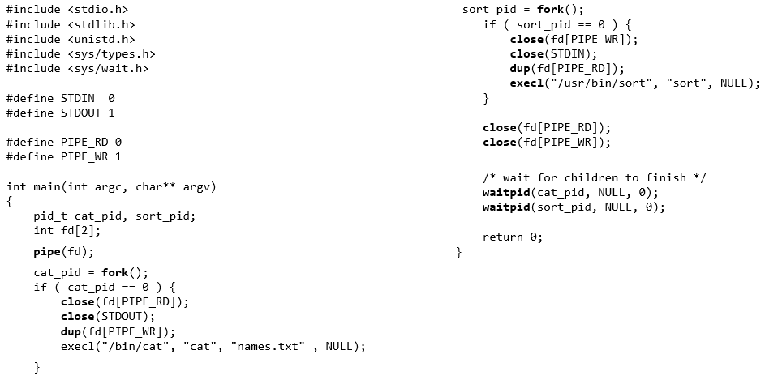
Pipe Example (2 of 2)
Notes:
Long Description:
The code lines from top to bottom are as follows.
hashtag include left angle bracket s t d i o dot h right bracket
hashtag include left angle bracket s t d l i b dot h right bracket
hashtag include left angle bracket u n i s t d dot h right bracket
hashtag include left angle bracket s y s forward slash types dot h right bracket
hashtag include left angle s y s forward slash wait fot h dot h right bracket
hashtag define S T D I N 0
hashtag define S T D I N 1
hashtag define PIPE underscore R D 0
hashtag define PIPE underscore W R 1
int main left parenthesis int a r g c comma char double asterisk a r g v right parentheses
left brace
p i d underscore t cat underscore p i d comma sort underscore p i d semicolon
int f d left brace 2 right brace semicolon
pipe left parenthesis f dright parenthesis semicolon
cat underscore pid equals fork left parenthesis right parenthesis semicolon
if left parenthesiscat underscore p i d equals equals 0 right parenthesis left brace
close left parenthesis f d left bracket PIPE underscore R D right bracket right parenthesis semicolon
close left parenthesis S T D O U T right parenthesis semicolon
d u p left parenthesis f d right bracket PIPE underscore R D left bracket right parenthesis semicolon
e x e c l left parenthesis double quotation / bin / cat double quotation comma double quotation cat double quotation comma double quotation names dot txt double quotation comma N U L L right parenthesis semicolon
right brace
sort underscore p i d equals fork left parenthesis right parenthesis semicolon
if left parenthesis sort underscore p i d equals equals 0 right parenthesis left brace
close left parenthesis f d left bracket PIPE underscore W R right bracket right parenthesis semicolon
close left parenthesis S T D I N right parenthesis semicolon
d u p left parenthesis f d right bracket PIPE underscore R D left bracket right parenthesis semicolon
e x e c l left parenthesis double quotation forward slash u s r forward slash bin forward slash sort double quotation comma double quotation sort double quotation comma double quotation names dot txt double quotation comma N U L L right parenthesis semicolon
right brace
close left parenthesis f d left bracket PIPE underscore R D right bracket right parenthesis semicolon
close left parenthesis f d left bracket PIPE underscore W R right bracket right parenthesis semicolon
forward slash asterisk wait for children to finish asterisk forward slash
wait p i d left parenthesis cat underscore p i d comma N U L L comma 0 right parenthesis semicolon
wait p i d left parenthesis sort underscore p i d comma N U L L comma 0 right parenthesis semicolon
return 0 semicolon
right brace

Slide 106
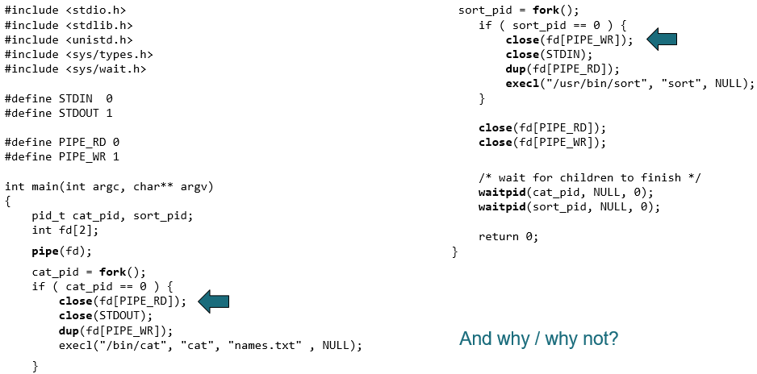
Pipe Example Quiz: Can we skip these closes?
Notes:
Long Description:
The code lines from top to bottom are as follows.
hashtag include left angle bracket s t d i o dot h right bracket
hashtag include left angle bracket s t d l i b dot h right bracket
hashtag include left angle bracket u n i s t d dot h right bracket
hashtag include left angle bracket s y s forward slash types dot h right bracket
hashtag include left angle s y s forward slash wait fot h dot h right bracket
hashtag define S T D I N 0
hashtag define S T D I N 1
hashtag define PIPE underscore R D 0
hashtag define PIPE underscore W R 1
int main left parenthesis int a r g c comma char double asterisk a r g v right parentheses
left brace
p i d underscore t cat underscore p i d comma sort underscore p i d semicolon
int f d left brace 2 right brace semicolon
pipe left parenthesis f dright parenthesis semicolon
cat underscore pid equals fork left parenthesis right parenthesis semicolon
if left parenthesiscat underscore p i d equals equals 0 right parenthesis left brace
close left parenthesis f d left bracket PIPE underscore R D right bracket right parenthesis semicolon
close left parenthesis S T D O U T right parenthesis semicolon
d u p left parenthesis f d right bracket PIPE underscore R D left bracket right parenthesis semicolon
e x e c l left parenthesis double quotation / bin / cat double quotation comma double quotation cat double quotation comma double quotation names dot txt double quotation comma N U L L right parenthesis semicolon
right brace
sort underscore p i d equals fork left parenthesis right parenthesis semicolon
if left parenthesis sort underscore p i d equals equals 0 right parenthesis left brace
close left parenthesis f d left bracket PIPE underscore W R right bracket right parenthesis semicolon
close left parenthesis S T D I N right parenthesis semicolon
d u p left parenthesis f d right bracket PIPE underscore R D left bracket right parenthesis semicolon
e x e c l left parenthesis double quotation forward slash u s r forward slash bin forward slash sort double quotation comma double quotation sort double quotation comma double quotation names dot txt double quotation comma N U L L right parenthesis semicolon
right brace
close left parenthesis f d left bracket PIPE underscore R D right bracket right parenthesis semicolon
close left parenthesis f d left bracket PIPE underscore W R right bracket right parenthesis semicolon
forward slash asterisk wait for children to finish asterisk forward slash
wait p i d left parenthesis cat underscore p i d comma N U L L comma 0 right parenthesis semicolon
wait p i d left parenthesis sort underscore p i d comma N U L L comma 0 right parenthesis semicolon
return 0 semicolon
right brace
Two arrows marks one code line each as follows.
close left parenthesis f d left bracket PIPE underscore R D right bracket right parenthesis semicolon
close left parenthesis f d left bracket PIPE underscore W R right bracket right parenthesis semicolon
The text on the bottom right reads and why forward slash why not question mark.

Slide 107
Recap
We have seen syscalls
How to start a new process
Simple shell example
Signals
Pipes

Slide 108
Metric Units
Exp. | Explicit | Prefix | Exp. | Explicit | Prefix
10 superscript negative 3 | 0 decimal point 0 0 1 | Milli | 10 superscript 3 | 1,000 | Kilo
10 superscript negative 6 | 0 decimal point 0 0 0 0 0 1 | Micro | 10 superscript 6 | 1,000,000 | Mega
10 superscript negative 9 | 0 decimal point 0 0 0 0 0 0 0 0 1 | Nano | 10 superscript 9 | 1,000,000,000 | Giga
10 superscript negative 12 | 0 decimal point 0 0 0 0 0 0 0 0 0 0 0 1 | Pico | 10 superscript 12 | 1,000,000,000,000 | Tera
10 superscript negative 15 | 0 decimal point 0 0 0 0 0 0 0 0 0 0 0 0 0 0 1 | Femto | 10 superscript 15 | 1,000,000,000,000,000 | Peta
10 superscript negative 18 | 0 decimal point 0 0 0 0 0 0 0 0 0 0 0 0 0 0 0 0 0 1 | atto | 10 superscript 18 | 1,000,000,000,000,000,000 | Exa
10 superscript negative 21 | 0 decimal point 0 0 0 0 0 0 0 0 0 0 0 0 0 0 0 0 0 0 0 0 1 | zepto | 10 superscript 21 | 1,000,000,000,000,000,000,000 | Zetta
10 superscript negative 24 | 0 decimal point 0 0 0 0 0 0 0 0 0 0 0 0 0 0 0 0 0 0 0 0 0 0 0 1 | yocto | 10 superscript 24 | 1,000,000,000,000,000,000,000,000 | Yotta
Figure 1.31 The principal metric prefixes.

Slide 109

Copyright
This work is protected by United States copyright laws and is provided solely for the use of instructors in teaching their courses and assessing student learning. Dissemination or sale of any part of this work (including on the World Wide Web) will destroy the integrity of the work and is not permitted. The work and materials from it should never be made available to students except by instructors using the accompanying text in their classes. All recipients of this work are expected to abide by these restrictions and to honor the intended pedagogical purposes and the needs of other instructors who rely on these materials.

